Slide 1
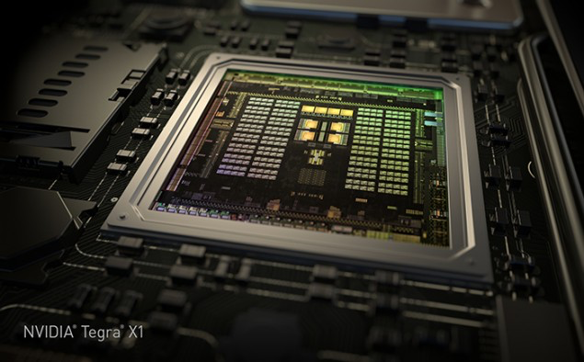
GPU Computing Architecture
/
HiPEAC Summer School, July 2015
Tor M. Aamodt
aamodt@ece.ubc.ca
University of British Columbia
NVIDIA Tegra X1 die photo

Slide 2
What is a GPU?
GPU = Graphics Processing Unit
Accelerator for raster based graphics (OpenGL, DirectX)
Highly programmable (Turing complete)
Commodity hardware
100’s of ALUs; 10’s of 1000s of concurrent threads

Slide 3
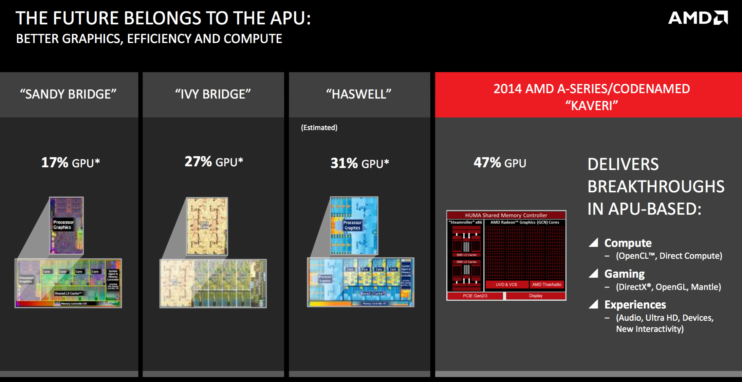
The GPU is Ubiquitous
+
[APU13 keynote]

Slide 4
“Early” GPU History
1981: IBM PC Monochrome Display Adapter (2D)
1996: 3D graphics (e.g., 3dfx Voodoo)
1999: register combiner (NVIDIA GeForce 256)
2001: programmable shaders (NVIDIA GeForce 3)
2002: floating-point (ATI Radeon 9700)
2005: unified shaders (ATI R520 in Xbox 360)
2006: compute (NVIDIA GeForce 8800)
Notes:
GPGPU
Origins
Use in supercomputing
CUDA => OpenCL => C++AMP, OpenACC, others
Use in Smartphones (e.g., Imagination PowerVR)
Cars (e.g., NVIDIA DRIVE PX)

Slide 5
GPU: The Life of a Triangle
+
process commands
Host
/
Front End
/
Vertex Fetch
transform vertices
Vertex Processing
to screen
-
space
generate per
-
Primitive Assembly
,
Setup
triangle equations
r
e
l
l
generate pixels
o
,
delete pixels
Rasterize
&
Zcull
r
t
that cannot be seen
n
o
C
Pixel Shader
r
e
f
f
u
determine the colors
B
,
transparencies
Texture
e
and depth of the pixel
m
a
r
F
do final hidden surface test,
blend
Pixel Engines
and write out color and new depth
(
ROP
)
[David Kirk / Wen-mei Hwu]

Slide 6

pixel color result of running “shader” program
+
Notes:
Each pixel the result of a single thread run on the GPU

Slide 7
Why use a GPU for computing?
GPU uses larger fraction of silicon for computation than CPU.
At peak performance GPU uses order of magnitude less energy per operation than CPU.
CPU
2nJ/op
GPU
200pJ/op
Rewrite Application
Order of Magnitude More Energy Efficient
However….
Application must perform well

Slide 8
GPU uses larger fraction of silicon for computation than CPU?
+
Control
ALU
ALU
ALU
ALU
Cache
DRAM
DRAM
CPU
GPU
[NVIDIA]

Slide 9
Growing Interest in GPGPU
Supercomputing – Green500.org Nov 2014
“the top three slots of the Green500 were powered by three different accelerators with number one, L-CSC, being powered by AMD FirePro™ S9150 GPUs; number two, Suiren, powered by PEZY-SC many-core accelerators; and number three, TSUBAME-KFC, powered by NVIDIA K20x GPUs. Beyond these top three, the next 20 supercomputers were also accelerator-based.”
Deep Belief Networks map very well to GPUs (e.g., Google keynote at 2015 GPU Tech Conf.)
http://blogs.nvidia.com/blog/2015/03/18/google-gpu/
http://www.ustream.tv/recorded/60071572

Slide 10
GPGPUs vs. Vector Processors
Similarities at hardware level between GPU and vector processors.
(I like to argue) SIMT programming model moves hardest parallelism detection problem from compiler to programmer.

Slide 11
Course Learning Objectives
After course you should be able to:
Explain motivation for investigating novel GPU-like computing architectures
Understand basic CUDA / PTX programs
Describe features of a generic GPU architecture representative of contemporary GPGPUs
Describe selected research on improving GPU computing programming models and hardware efficiency

Slide 12
Further Reading?
The following title is under development:
Tor M. Aamodt, Wilson W. L. Fung, Tim G. Rogers, General Purpose Graphics Processor Architectures , Morgan and Claypool (late 2015 or early 2016)
Other resources (primarily research papers) will be mentioned throughout the lectures.

Slide 13
Course Outline
Part 1: Introduction to GPGPU Programming Model
Part 2: Generic GPGPU Architecture
Part 3: Research Directions
Mitigating SIMT Control Divergence
Mitigating High GPGPU Memory Bandwidth Demands
Coherent Memory for Accelerators
Easier Programming with Synchronization

Slide 14
Part 1: Introduction to GPGPU Programming Model

Slide 15
GPGPU Programming Resources
9 week MOOC covering CUDA, OpenCL, C++AMP and OpenACChttps://www.coursera.org/course/hetero
Kirk and Hwu, Programming Massively Parallel Processors, Morgan Kaufmann, 2nd edition, 2014 (NOTE: 2nd edition includes coverage of OpenCL, C++AMP, and OpenACC)

Slide 16
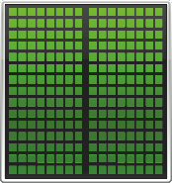
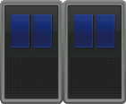
GPU Compute Programming Model
CPU GPU
How is this system programmed (today)?

Slide 17
GPGPU Programming Model
+
CPU “Off-load” parallel kernels to GPU
Transfer data to GPU memory
GPU HW spawns threads
Need to transfer result data back to CPU main memory
CPU
CPU
CPU
spawn
spawn
done
GPU
GPU
Time
17

Slide 18
CUDA/OpenCL Threading Model
CPU spawns fork-join style “grid” of parallel threads
kernel()
thread block 0
thread block 1
thread block N
thread grid
Spawns more threads than GPU can run (some may wait)
Organize threads into “blocks” (up to 1024 threads per block)
Threads can communicate/synchronize with other threads in block
Threads/Blocks have an identifier (can be 1, 2 or 3 dimensional)
Each kernel spawns a “grid” containing 1 or more thread blocks.
Motivation: Write parallel software once and run on future hardware

Slide 19
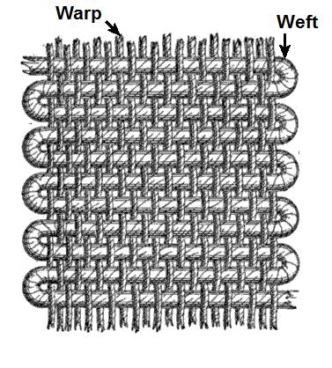
SIMT Execution Model
Programmers sees MIMD threads (scalar)
GPU bundles threads into warps (wavefronts) and runs them in lockstep on SIMD hardware
An NVIDIA warp groups 32 consecutive threads together (AMD wavefronts group 64 threads together)
Aside: Why “Warp”? In the textile industry, the term “warp” refers to “the threads stretched lengthwise in a loom to be crossed by the weft” [Oxford Dictionary].
Jacquard Loom => Babbage’s Analytical Engine => … => GPU.
[https://en.wikipedia.org/wiki/Warp_and_woof]
Notes:
MIMD = multiple-instruction, multiple-data

Slide 20
SIMT Execution Model
Challenge: How to handle branch operations when different threads in a warp follow a different path through program?
Solution: Serialize different paths.
foo[] = {4,8,12,16};
A
T1
T2
T3
T4
A: v = foo[threadIdx.x];
B: if (v < 10)
C: v = 0;
else
D: v = 10;
E: w = bar[threadIdx.x]+v;
B
T1
T2
T3
T4
C
Time
T1
T2
D
T3
T4
E
T1
T2
T3
T4
Notes:
MIMD = multiple-instruction, multiple-data

Slide 21
CUDA Syntax Extensions
Declaration specifiers
__global__ void foo(...); // kernel entry point (runs on GPU)
__device__ void bar(...); // function callable from a GPU thread
Syntax for kernel launch
foo<<<500, 128>>>(...); // 500 thread blocks, 128 threads each
Built in variables for thread identification
dim3 threadIdx; dim3 blockIdx; dim3 blockDim;

Slide 22
Example: Original C Code
void saxpy_serial(int n, float a, float *x, float *y)
{
for (int i = 0; i < n; ++i)
y[i] = a*x[i] + y[i];
}
int main() {
// omitted: allocate and initialize memory
saxpy_serial(n, 2.0, x, y); // Invoke serial SAXPY kernel
// omitted: using result
}
Notes:
saxpy = single precision ax + y

Slide 23
CUDA Code
__global__ void saxpy(int n, float a, float *x, float *y) {
int i = blockIdx.x*blockDim.x + threadIdx.x;
if(i<n) y[i]=a*x[i]+y[i];
}
int main() {
// omitted: allocate and initialize memory
int nblocks = (n + 255) / 256;
cudaMalloc((void**) &d_x, n);
cudaMalloc((void**) &d_y, n);
cudaMemcpy(d_x,h_x,n*sizeof(float),cudaMemcpyHostToDevice);
cudaMemcpy(d_y,h_y,n*sizeof(float),cudaMemcpyHostToDevice);
saxpy<<<nblocks, 256>>>(n, 2.0, d_x, d_y);
cudaMemcpy(h_y,d_y,n*sizeof(float),cudaMemcpyDeviceToHost);
// omitted: using result
}
Runs on GPU
Notes:
saxpy = single precision ax + y

Slide 24
OpenCL Code
__kernel void saxpy(int n, float a, __global float *x, __global float *y) {
int i = get_global_id(0);
if(i<n) y[i]=a*x[i]+y[i];
}
int main() {
// omitted: allocate and initialize memory on host, variable declarations
int nblocks = (n + 255) / 256;
int blocksize = 256;
clGetPlatformIDs(1, &cpPlatform, NULL);
clGetDeviceIDs(cpPlatform, CL_DEVICE_TYPE_GPU, 1, &cdDevice, NULL);
cxGPUContext = clCreateContext(0, 1, &cdDevice, NULL, NULL, &ciErr1);
cqCommandQueue = clCreateCommandQueue(cxGPUContext, cdDevice, 0, &ciErr1);
dx = clCreateBuffer(cxGPUContext, CL_MEM_READ_ONLY, sizeof(cl_float) * n, NULL, &ciErr1);
dy = clCreateBuffer(cxGPUContext, CL_MEM_READ_WRITE, sizeof(cl_float) * n, NULL, &ciErr1);
// omitted: loading program into char string cSourceCL
cpProgram = clCreateProgramWithSource(cxGPUContext, 1, (const char **)&cSourceCL, &szKernelLength, &ciErr1);
clBuildProgram(cpProgram, 0, NULL, NULL, NULL, NULL);
ckKernel = clCreateKernel(cpProgram, “saxpy_serial”, &ciErr1);
clSetKernelArg(ckKernel, 0, sizeof(cl_int), (void*)&n);
clSetKernelArg(ckKernel, 1, sizeof(cl_float), (void*)&a);
clSetKernelArg(ckKernel, 2, sizeof(cl_mem), (void*)&dx);
clSetKernelArg(ckKernel, 3, sizeof(cl_mem), (void*)&dy);
clEnqueueWriteBuffer(cqCommandQueue, dx, CL_FALSE, 0, sizeof(cl_float) * n, x, 0, NULL, NULL);
clEnqueueWriteBuffer(cqCommandQueue, dy, CL_FALSE, 0, sizeof(cl_float) * n, y, 0, NULL, NULL);
clEnqueueNDRangeKernel(cqCommandQueue, ckKernel, 1, NULL, &nblocks, & blocksize, 0, NULL, NULL);
clEnqueueReadBuffer(cqCommandQueue, dy, CL_TRUE, 0, sizeof(cl_float) * n, y, 0, NULL, NULL);
// omitted: using result
}
Runs on GPU

Slide 25
C++AMP Example Code
#include <amp.h>
using namespace concurrency;
int main() {
// omitted: allocation and initialization of y and x
array_view<int> xv(n, x);
array_view<int> yv(n, y);
parallel_for_each(yv.get_extent(), [=](index<1> i) restrict(amp) {
yv[i] = a * xv[i] + yv[i];
});
yv.synchronize();
// omitted: using result
}
Runs on GPU
Notes:
saxpy = single precision ax + y

Slide 26
OpenACC Example Code
void saxpy_serial(int n, float a, float *x, float *y)
{
#pragma acc kernels
for (int i = 0; i < n; ++i)
y[i] = a*x[i] + y[i];
}
Runs on GPU
Notes:
saxpy = single precision ax + y

Slide 27
Review: Memory
E.g., use to save state between steps in a computation.
Each memory location has an associated address which identifies the location. The location contains a value:
address | value
0 | 0xFF
1 | 0x42
2 | 0x00
3 | 0x01
Example: Memory with 4 one byte locations. Location with address 1 contains value 0x42.

Slide 28
GPU Memory Address Spaces
GPU has three address spaces to support increasing visibility of data between threads: local, shared, global
In addition two more (read-only) address spaces: Constant and texture.

Slide 29
Local (Private) Address Space
Each thread has own “local memory” (CUDA) “private memory” (OpenCL).
0x42
Note: Location at address 100 for thread 0 is different from location at address 100 for thread 1.
Contains local variables private to a thread.

Slide 30
Global Address Spaces
Each thread in the different thread blocks (even from different kernels) can access a region called “global memory” (CUDA/OpenCL).
Commonly in GPGPU workloads threads write their own portion of global memory. Avoids need for synchronization—slow; also unpredictable thread block scheduling.
thread block X
thread block Y
0x42

Slide 31
History of “global memory”
Prior to NVIDIA GeForce 8800 and CUDA 1.0, access to memory was through texture reads and raster operations for writing.
Problem: Address of memory access was highly constrained function of thread ID.
CUDA 1.0 enabled access to arbitrary memory location in a flat memory space called “global”

Slide 32
Example: Transpose (CUDA SDK)
__global__ void transposeNaive(float *odata, float* idata, int width, int height)
{
int xIndex = blockIdx.x * TILE_DIM + threadIdx.x; // TILE_DIM = 16
int yIndex = blockIdx.y * TILE_DIM + threadIdx.y;
int index_in = xIndex + width * yIndex;
int index_out = yIndex + height * xIndex;
for (int i=0; i<TILE_DIM; i+=BLOCK_ROWS) { // BLOCK_ROWS = 16
odata[index_out+i] = idata[index_in+i*width];
}
}
1 | 2
3 | 4
1 | 3
2 | 4
NOTE: “xIndex”, “yIndex”, “index_in”, “index_out”, and “i” are in local memory
(local variables are register allocated but stack lives in local memory)
“odata” and “idata” are pointers to global memory
(both allocated using calls to cudaMalloc -- not shown above)

Slide 33
“Coalescing” global accesses
Not same as CPU write combining/buffering:
Aligned accesses request single 128B cache blk
Memory Divergence:
128
255
ld.global r1,0(r2)
128
256
1024
1152
ld.global r1,0(r2)

Slide 34
Example: Transpose (CUDA SDK)
__global__ void transposeNaive(float *odata, float* idata, int width, int height)
{
int xIndex = blockIdx.x * TILE_DIM + threadIdx.x;
int yIndex = blockIdx.y * TILE_DIM + threadIdx.y;
int index_in = xIndex + width * yIndex;
int index_out = yIndex + height * xIndex;
for (int i=0; i<TILE_DIM; i+=BLOCK_ROWS) {
odata[index_out+i] = idata[index_in+i*width];
}
}
Assume height=16 and consider i=0:
Thread x=0,y=0 has xIndex=0, yIndex=0 so accesses odata[0]
Thread x=1,y=0 has xIndex=1, yIndex=0 so accesses odata[16]
Write to global memory highlighted above is not “coalesced”.

Slide 35
Redundant Global Memory Accesses
__global__ void matrixMul (float *C, float *A, float *B, int N)
{
int xIndex = blockIdx.x * BLOCK_SIZE + threadIdx.x;
int yIndex = blockIdx.y * BLOCK_SIZE + threadIdx.y;
float sum = 0;
for (int k=0; k<N; i++)
sum += A[yIndex][k] * B[k][xIndex];
C[yIndex][xIndex] = sum;
}
E.g., both thread x=0,y=0 and thread x=32, y=0 access A[0][0] potentially causing two accesses to off-chip DRAM. In general, each element of A and B is redundantly fetched O(N) times.

Slide 36
Tiled Multiply Using Thread Blocks [David Kirk & Wen-mei Hwu / UIUC ECE 498AL]
+
bx
0
1
2
tx
One block computes one square sub-matrix P_{sub} of size BLOCK_SIZE
One thread computes one element of P_{sub}
Assume that the dimensions of M and N are multiples of BLOCK_SIZE and square shape
0
bsize-1
1
2
N
BLOCK_SIZE
WIDTH
BLOCK_SIZE
M
P
0
0
P_{sub}
1
by
2
WIDTH
1
ty
BLOCK_SIZE
bsize-1
2
BLOCK_SIZE
BLOCK_SIZE
BLOCK_SIZE
WIDTH
WIDTH

Slide 37
History of “shared memory”
Prior to NVIDIA GeForce 8800 and CUDA 1.0, threads could not communicate with each other through on-chip memory.
“Solution”: small (16-48KB) programmer managed scratchpad memory shared between threads within a thread block.

Slide 38
Shared (Local) Address Space
Each thread in the same thread block (work group) can access a memory region called “shared memory” (CUDA) “local memory” (OpenCL).
Shared memory address space is limited in size (16 to 48 KB).
Used as a software managed “cache” to avoid off-chip memory accesses.
Synchronize threads in a thread block using __syncthreads();
thread block
0x42

Slide 39
Optimizing Transpose for Coalescing
Step 1: Read block of data into shared memory
idata
1 | 2
3 | 4
1 | 2
3 | 4
Step 2: Copy from shared memory into global memory using coalesce write
odata
1 | 2
3 | 4
1 | 3
2 | 4

Slide 40
Optimizing Transpose for Coalescing
__global__ void transposeCoalesced(float *odata, float *idata, int width, int height)
{
__shared__ float tile[TILE_DIM][TILE_DIM];
int xIndex = blockIdx.x * TILE_DIM + threadIdx.x;
int yIndex = blockIdx.y * TILE_DIM + threadIdx.y;
int index_in = xIndex + (yIndex)*width;
xIndex = blockIdx.y * TILE_DIM + threadIdx.x;
yIndex = blockIdx.x * TILE_DIM + threadIdx.y;
int index_out = xIndex + (yIndex)*height;
for (int i=0; i<TILE_DIM; i+=BLOCK_ROWS) {
tile[threadIdx.y+i][threadIdx.x] = idata[index_in+i*width];
}
__syncthreads(); // wait for all threads in block to finish above for loop
for (int i=0; i<TILE_DIM; i+=BLOCK_ROWS) {
odata[index_out+i*height] = tile[threadIdx.x][threadIdx.y+i];
}
}
GOOD: Coalesced write
BAD: Shared memory bank conflicts

Slide 41
Review: Bank Conflicts
To increase bandwidth common to organize memory into multiple banks.
Independent accesses to different banks can proceed in parallel
Bank 0
Bank 1
Bank 0
Bank 1
Bank 0
Bank 1
0
2
4
6
1
3
5
7
0
2
4
6
1
3
5
7
0
2
4
6
1
3
5
7
Example 1: Read 0, Read 1
(can proceed in parallel)
Example 2: Read 0, Read 3
(can proceed in parallel)
Example 3: Read 0, Read 2
(bank conflict)

Slide 42
Shared Memory Bank Conflicts
__shared__ int A[BSIZE];
…
A[threadIdx.x] = … // no conflicts
0
32
64
96
1
33
65
97
2
34
66
98
31
63
95
127

Slide 43
Shared Memory Bank Conflicts
__shared__ int A[BSIZE];
…
A[2*threadIdx.x] = // 2-way conflict
0
32
64
96
1
33
65
97
2
34
66
98
31
63
95
127

Slide 44
Optimizing Transpose for Coalescing
Step 1: Read block of data into shared memory
idata
1 | 2
3 | 4
1 | 2
3 | 4
Step 2: Copy from shared memory into global memory using coalesce write
odata
1 | 2
3 | 4
Problem: Access two locations in same
shared memory bank.
1 | 3
2 | 4

Slide 45
+ Eliminate Bank Conflicts
__global__ void transposeNoBankConflicts (float *odata, float *idata, int width, int height)
{
__shared__ float tile[TILE_DIM][TILE_DIM+1];
int xIndex = blockIdx.x * TILE_DIM + threadIdx.x;
int yIndex = blockIdx.y * TILE_DIM + threadIdx.y;
int index_in = xIndex + (yIndex)*width;
xIndex = blockIdx.y * TILE_DIM + threadIdx.x;
yIndex = blockIdx.x * TILE_DIM + threadIdx.y;
int index_out = xIndex + (yIndex)*height;
for (int i=0; i<TILE_DIM; i+=BLOCK_ROWS) {
tile[threadIdx.y+i][threadIdx.x] = idata[index_in+i*width];
}
__syncthreads();
for (int i=0; i<TILE_DIM; i+=BLOCK_ROWS) {
odata[index_out+i*height] = tile[threadIdx.x][threadIdx.y+i];
}
}

Slide 46
Optimizing Transpose for Coalescing
Step 1: Read block of data into shared memory
idata
1 | 2
3 | 4
Bank 0
Bank 1
1 | 2
 | 3
4
Step 2: Copy from shared memory into global memory using coalesce write
odata
Bank 0
Bank 1
1 | 2
 | 3
4
1 | 3
2 | 4

Slide 47
CUDA Streams
CUDA (and OpenCL) provide the capability to overlap computation on GPU with memory transfers using “Streams” (Command Queues)
A Stream orders a sequence of kernels and memory copy “operations”.
Operations in one stream can overlap with operations in a different stream.

Slide 48
How Can Streams Help?
Serial:
Streams:
cudaMemcpy(H2D)
kernel<<<>>>
cudaMemcpy(D2H)
GPU idle
GPU busy
GPU idle
cudaMemcpy(H2D)
K0
DH0
K1
DH1
Savings
K2
DH2
Time
http://on-demand.gputechconf.com/gtc-express/2011/presentations/StreamsAndConcurrencyWebinar.pdf

Slide 49
CUDA Streams
cudaStream_t streams[3];
for(i=0; i<3; i++)
cudaStreamCreate(&streams[i]); // initialize streams
for(i=0; i<3; i++) {
cudaMemcpyAsync(pD+i*size,pH+i*size,size,
cudaMemcpyHostToDevice,stream[i]); // H2D
MyKernel<<<grid,block,0,stream[i]>>>(pD+i,size); // compute
cudaMemcpyAsync(pD+i*size,pH+i*size,size,
cudaMemcpyDeviceToHost,stream[i]); // D2H
}

Slide 50
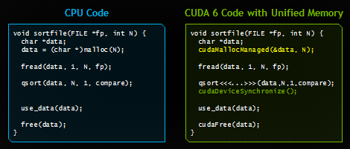
Recent Features in CUDA
Dynamic Parallelism (CUDA 5): Launch kernels from within a kernel. Reduce work for e.g., adaptive mesh refinement.
Unified Memory (CUDA 6): Avoid need for explicit memory copies between CPU and GPU
http://devblogs.nvidia.com/parallelforall/unified-memory-in-cuda-6/
See also, Gelado, et al. ASPLOS 2010.

Slide 51
GPU Instruction Set Architecture (ISA)
NVIDIA defines a virtual ISA, called “PTX” (Parallel Thread eXecution)
More recently, Heterogeneous System Architecture (HSA) Foundation (AMD, ARM, Imagination, Mediatek, Samsung, Qualcomm, TI) defined the HSAIL virtual ISA.
PTX is Reduced Instruction Set Architecture (e.g., load/store architecture)
Virtual: infinite set of registers (much like a compiler intermediate representation)
PTX translated to hardware ISA by backend compiler (“ptxas”). Either at compile time (nvcc) or at runtime (GPU driver).

Slide 52
Some Example PTX Syntax
Registers declared with a type:
.reg .pred p, q, r;
.reg .u16 r1, r2;
.reg .f64 f1, f2;
ALU operations
add.u32 x, y, z; // x = y + z
mad.lo.s32 d, a, b, c; // d = a*b + c
Memory operations:
ld.global.f32 f, [a];
ld.shared.u32 g, [b];
st.local.f64 [c], h
Compare and branch operations:
setp.eq.f32 p, y, 0; // is y equal to zero?
@p bra L1 // branch to L1 if y equal to zero

Slide 53
Part 2: Generic GPGPU Architecture

Slide 54
Extra resources
GPGPU-Sim 3.x Manualhttp://gpgpu-sim.org/manual/index.php/GPGPU-Sim_3.x_Manual

Slide 55
GPU Microarchitecture Overview
Single-Instruction, Multiple-Threads
GPU
SIMT Core Cluster
SIMT Core Cluster
SIMT Core Cluster
SIMT
Core
SIMT
Core
SIMT
Core
SIMT
Core
SIMT
Core
SIMT
Core
Interconnection Network
Memory
Partition
Memory
Partition
Memory
Partition
GDDR5
GDDR5
Off-chip DRAM
GDDR5

Slide 56
GPU Microarchitecture
Companies tight lipped about details of GPU microarchitecture.
Several reasons:
Competitive advantage
Fear of being sued by “non-practicing entities”
The people that know the details too busy building the next chip
Model described next, embodied in GPGPU-Sim, developed from: white papers, programming manuals, IEEE Micro articles, patents.

Slide 57
GPGPU-Sim v3.x w/ SASS
Correlation
~0.976
12

Slide 58
GPU Microarchitecture Overview
GPU
SIMT Core Cluster
SIMT Core Cluster
SIMT Core Cluster
SIMT
Core
SIMT
Core
SIMT
Core
SIMT
Core
SIMT
Core
SIMT
Core
Interconnection Network
Memory
Partition
Memory
Partition
Memory
Partition
GDDR3/GDDR5
GDDR3/GDDR5
Off-chip DRAM
GDDR3/GDDR5

Slide 59
Inside a SIMT Core
SIMT
Front End
Reg
File
SIMD Datapath
Fetch
Decode
Memory Subsystem
Icnt.
Network
Schedule
Branch
SMem
L1 D$
Tex $
Const$
SIMT front end / SIMD backend
Fine-grained multithreading
Interleave warp execution to hide latency
Register values of all threads stays in core

Slide 60
Inside an “NVIDIA-style” SIMT Core
SIMT Front End
SIMD Datapath
Branch Target PC
Fetch
SIMT-Stack
Scheduler 1
Scheduler 3
ALU
Valid[1:N]
Active
ALU
I-Buffer
Pred.
ALU
Mask
ALU
I-Cache
Decode
Issue
Operand
Scheduler 2
Collector
Score
MEM
Board
Done (WID)
Three decoupled warp schedulers
Scoreboard
Large register file
Multiple SIMD functional units

Slide 61
Fetch + Decode
Arbitrate the I-cache among warps
Cache miss handled by fetching again later
Fetched instruction is decoded and then stored in the I-Buffer
1 or more entries / warp
Only warp with vacant entries are considered in fetch
Score-
PC
Decode
Board
A
1
PC
v
Inst. W1
r
R
2
e
B
PC
3
v
Inst. W2
r
h
c
v
Inst. W3
r
a
C
-
I
o
Selection
T
To
Fetch
Issue
Valid[1:N]
Issue
ARB
Fetch
Valid[1:N]
I-Buffer
I-Cache
Decode

Slide 62
Instruction Issue
Select a warp and issue an instruction from its I-Buffer for execution
Scheduling: Greedy-Then-Oldest (GTO)
GT200/later Fermi/Kepler: Allow dual issue (superscalar)
Fermi: Odd/Even scheduler
To avoid stalling pipeline might
keep instruction in I-buffer until
know it can complete (replay)

Slide 63
Review: In-order Scoreboard
+
Scoreboard: a bit-array, 1-bit for each register
If the bit is not set: the register has valid data
If the bit is set: the register has stale data
i.e., some outstanding instruction is going to change it
Issue in-order: RD ← Fn (RS, RT)
If SB[RS] or SB[RT] is set → RAW, stall
If SB[RD] is set → WAW, stall
Else, dispatch to FU (Fn) and set SB[RD]
Complete out-of-order
Update GPR[RD], clear SB[RD]
Scoreboard
Register File
0
Regs[R1]
1
Regs[R2]
0
Regs[R3]
0
Regs[R31]
[Gabriel Loh]
Notes:
H&P-style notation

Slide 64
In-Order Scoreboard for GPUs?
+
Problem 1: 32 warps, each with up to 128 (vector) registers per warp means scoreboard is 4096 bits.
Problem 2: Warps waiting in I-buffer needs to have dependency updated every cycle.
Solution?
Flag instructions with hazards as not ready in I-Buffer so not considered by scheduler
Track up to 6 registers per warp (out of 128)
I-buffer 6-entry bitvector: 1b per register dependency
Lookup source operands, set bitvector in I-buffer. As results written per warp, clear corresponding bit

Slide 65
Example
+
Code
ld r7, [r0]
mul r6, r2, r5
add r8, r6, r7
Scoreboard
Instruction Buffer
Index 0
Index 1
Index 2
Index 3
i0 i1 i2 i3
Warp 0
r7 | - | - | -
- | - | - | -
r7 | r6 | - | -
- | - | - | -
r7 | r6 | r8 | -
- | - | - | -
r7 | r6 | r8 | -
- | - | - | -
r7 | - | r8 | -
- | - | - | -
r7 | - | r8 | -
- | - | - | -
- | - | r8 | -
- | - | - | -
Warp 0
- | - | - | -
- | - | - | -
ld r7, [r0] | 0 | 0 | 0 | 0
ld r7, [r0] | 0 | 0 | 0 | 0
mul r6, r2, r5 | 0 | 0 | 0 | 0
ld r7, [r0] | 0 | 0 | 0 | 0
mul r6, r2, r5 | 0 | 0 | 0 | 0
add r8, r6, r7 | 1 | 1 | 0 | 0
ld r7, [r0] | 0 | 0 | 0 | 0
mul r6, r2, r5 | 0 | 0 | 0 | 0
add r8, r6, r7 | 1 | 1 | 0 | 0
ld r7, [r0] | 0 | 0 | 0 | 0
add r8, r6, r7 | 1 | 0 | 0 | 0
ld r7, [r0] | 0 | 0 | 0 | 0
add r8, r6, r7 | 1 | 0 | 0 | 0
add r8, r6, r7 | 0 | 0 | 0 | 0
Warp 1
Warp 1

Slide 66
SIMT Using a Hardware Stack
Stack approach invented at Lucafilm, Ltd in early 1980’s
Version here from [Fung et al., MICRO 2007]
Stack
A
A/1111
Reconv. PC
Next PC
Active Mask
TOS
TOS
TOS
TOS
-
-
-
-
-
-
-
G
A
E
E
B
E
E
1111
1111
1111
1111
1111
1111
1111
E
E
D
D
0110
TOS
E
D
0110
0110
B
B/1111
TOS
TOS
E
E
C
E
1001
1001
C/1001
D/0110
C
D
F
Thread Warp
Common PC
E
E/1111
Thread
1
Thread
2
Thread
3
Thread
4
G
G/1111
A
B
C
D
E
G
A
Time
SIMT = SIMD Execution of Scalar Threads

Slide 67
SIMT Notes
Execution mask stack implemented with special instructions to push/pop. Descriptions can be found in AMD ISA manual and NVIDIA patents.
In practice augment stack with predication (lower overhead).

Slide 68
SIMT outside of GPUs?
ARM Research looking at SIMT-ized ARM ISA.
Intel MIC implements SIMT on top of vector hardware via compiler (ISPC)
Possibly other industry players in future

Slide 69
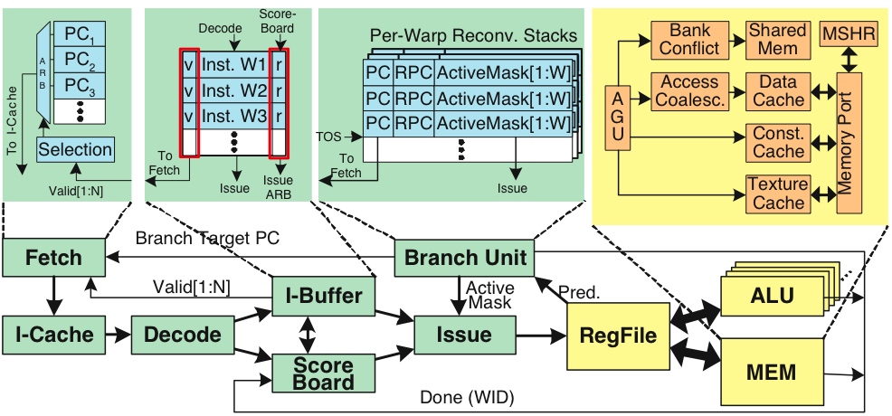
Register File
32 warps, 32 threads per warp, 16 x 32-bit registers per thread = 64KB register file.
Need “4 ports” (e.g., FMA) greatly increase area.
Alternative: banked single ported register file. How to avoid bank conflicts?

Slide 70
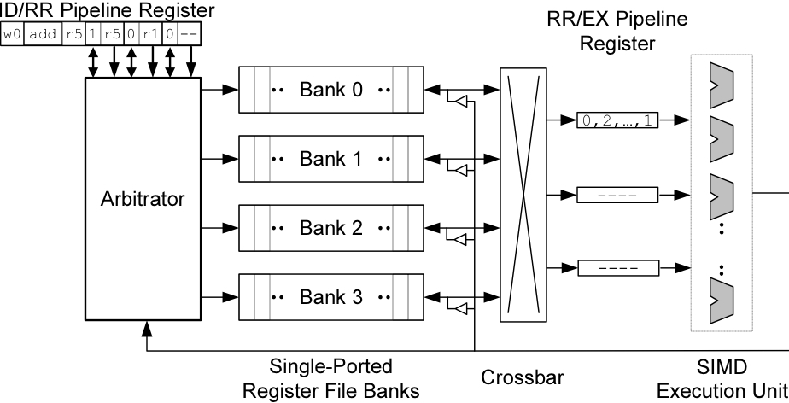
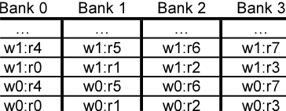
Banked Register File
Strawman microarchitecture:
Register layout:

Slide 71
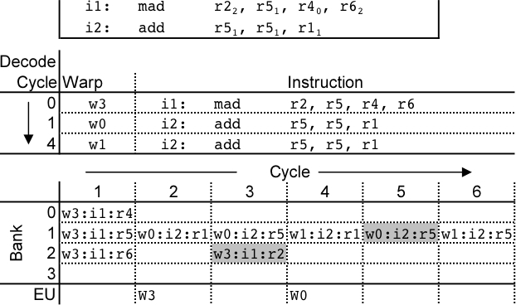
Register Bank Conflicts
warp 0, instruction 2 has two source operands in bank 1: takes two cycles to read.
Also, warp 1 instruction 2 is same and is also stalled.
Can use warp ID as part of register layout to help.

Slide 72
Operand Collector
Bank 0
Bank 1
Bank 2
Bank 3
R0
R1
R2
R3
R4
R5
R6
R7
R8
R9
R10
R11
…
…
…
…
add.s32 R3, R1, R2;
No Conflict
mul.s32 R3, R0, R4;
Conflict at bank 0
Term “Operand Collector” appears in figure in NVIDIA Fermi Whitepaper
Operand Collector Architecture (US Patent: 7834881)
Interleave operand fetch from different threads to achieve full utilization

Slide 73
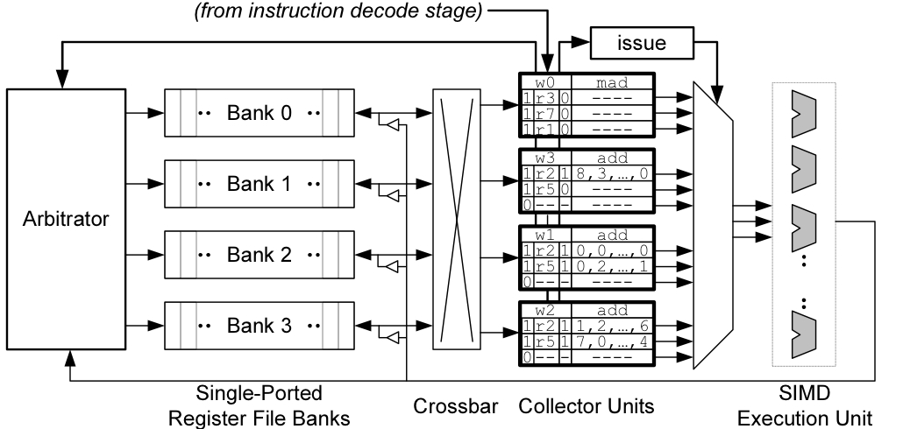
Operand Collector (1)
Issue instruction to collector unit.
Collector unit similar to reservation station in tomasulo’s algorithm.
Stores source register identifiers.
Arbiter selects operand accesses that do not conflict on a given cycle.
Arbiter needs to also consider writeback (or need read+write port)

Slide 74
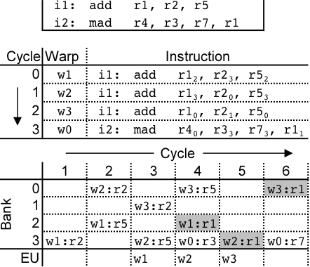
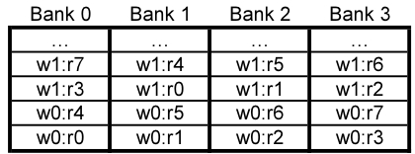
Operand Collector (2)
Combining swizzling and access scheduling can give up to ~ 2x improvement in throughput

Slide 75
AMD Southern Islands
SIMT processing often includes redundant computation across threads.
thread 0…31:
for( i=0; i < runtime_constant_N; i++ {
/* do something with “i” */
}

Slide 76
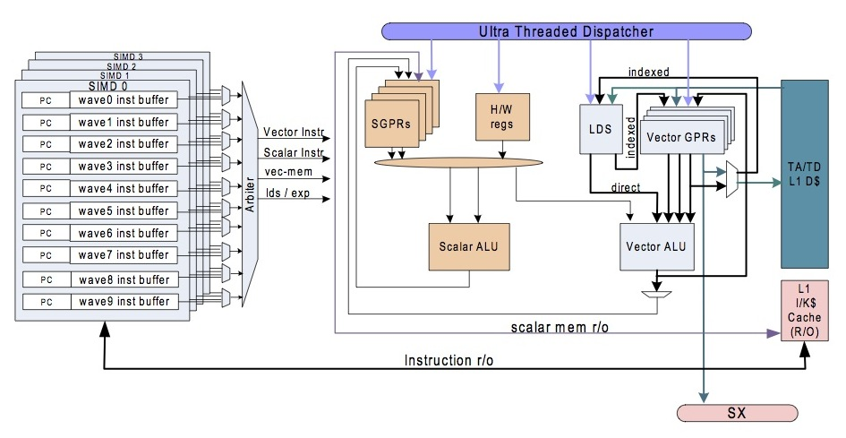
AMD Southern Islands SIMT-Core
ISA visible scalar unit executes computation identical across SIMT threads in a wavefront

Slide 77
Example
float fn0(float a,float b)
{
if(a>b)
return (a * a – b);
else
return (b * b – a);
}
// Registers r0 contains “a”, r1 contains “b”
// Value is returned in r2
v_cmp_gt_f32 r0, r1 // a>b
s_mov_b64 s0, exec // Save current exec mask
s_and_b64 exec, vcc, exec // Do “if”
s_cbranch_vccz label0 // Branch if all lanes fail
v_mul_f32 r2, r0, r0 // result = a * a
v_sub_f32 r2, r2, r1 // result = result - b
label0:
s_not_b64 exec, exec // Do “else”
s_and_b64 exec, s0, exec // Do “else”
s_cbranch_execz label1 // Branch if all lanes fail
v_mul_f32 r2, r1, r1 // result = b * b
v_sub_f32 r2, r2, r0 // result = result - a
label1:
s_mov_b64 exec, s0 // Restore exec mask
[Southern Islands Series Instruction Set Architecture, Aug. 2012]

Slide 78
Southern Islands SIMT Stack?
+
Instructions: S_CBRANCH_*_FORK; S_CBRANCH_JOIN
Use for arbitrary (e.g., irreducible) control flow
3-bit control stack pointer
Six 128-bit stack entries; stored in scalar general purpose registers holding {exec[63:0], PC[47:2]}
S_CBRANCH_*_FORK executes path with fewer active threads first

Slide 79
Part 3: Research Directions

Slide 80

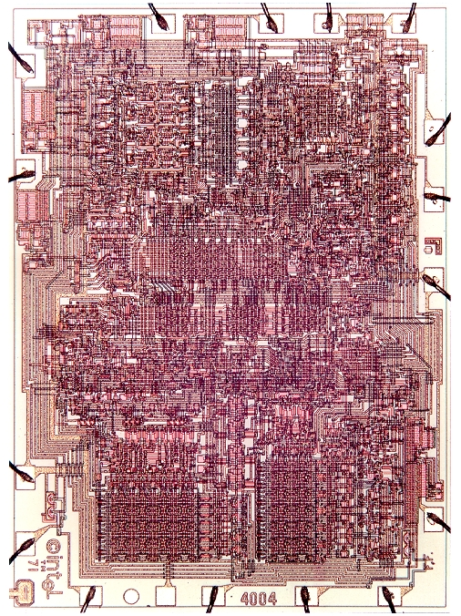

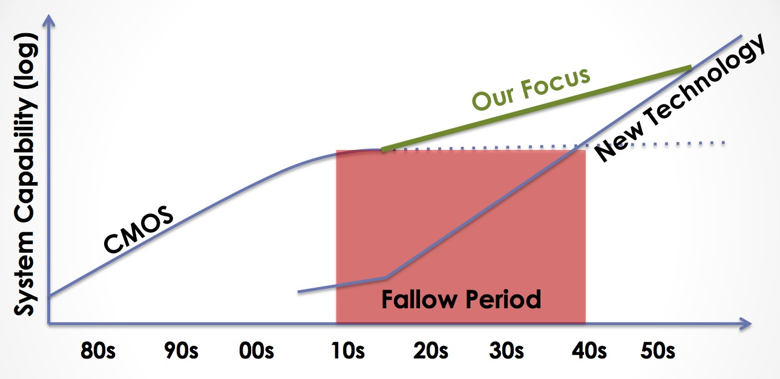

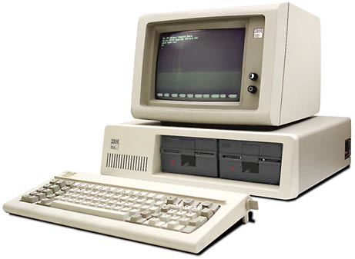

Decreasing cost per unit computation
1971: Intel 4004
2007: iPhone
Advancing Computer Systems without Technology Progress
DARPA/ISAT Workshop, March 26-27, 2012
Mark Hill & Christos Kozyrakis
2012: Datacenter
1981: IBM 5150
Notes:
Increasing transistor density has led to decreasing cost per unit computation… or what is equivalent increased capability per unit cost.
This leads to a rather famous exponential growth curve.
A quick review of the impact of this curve is in order:
- First microprocessor had 2300 transistors basically designed for a souped up calculator
- Today we carry around smartphones that have half a billion transistors in them. A large part of what makes them useful is the computing capability that resulted from technology scaling.
- Of course, not all computation takes place somewhere you can see it. A large amount of computation happens in datacenters that are hidden away out of sight behind the internet.
However, the traditional CMOS scaling that gave us all this is ending. ITRS projects we’ll end at the 7 nm process node. Others may put it at 5 nm. But either way this is happening really soon and likely within the next 10 years.
Of course, there are other technologies being proposed. However, none of them are ready for prime time.
Open question: can we continue increasing function per unit cost without CMOS scaling?

Slide 81
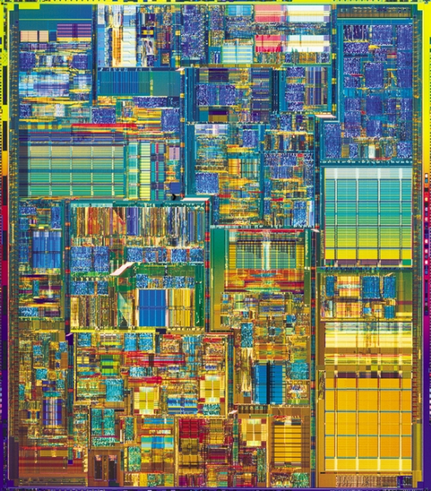
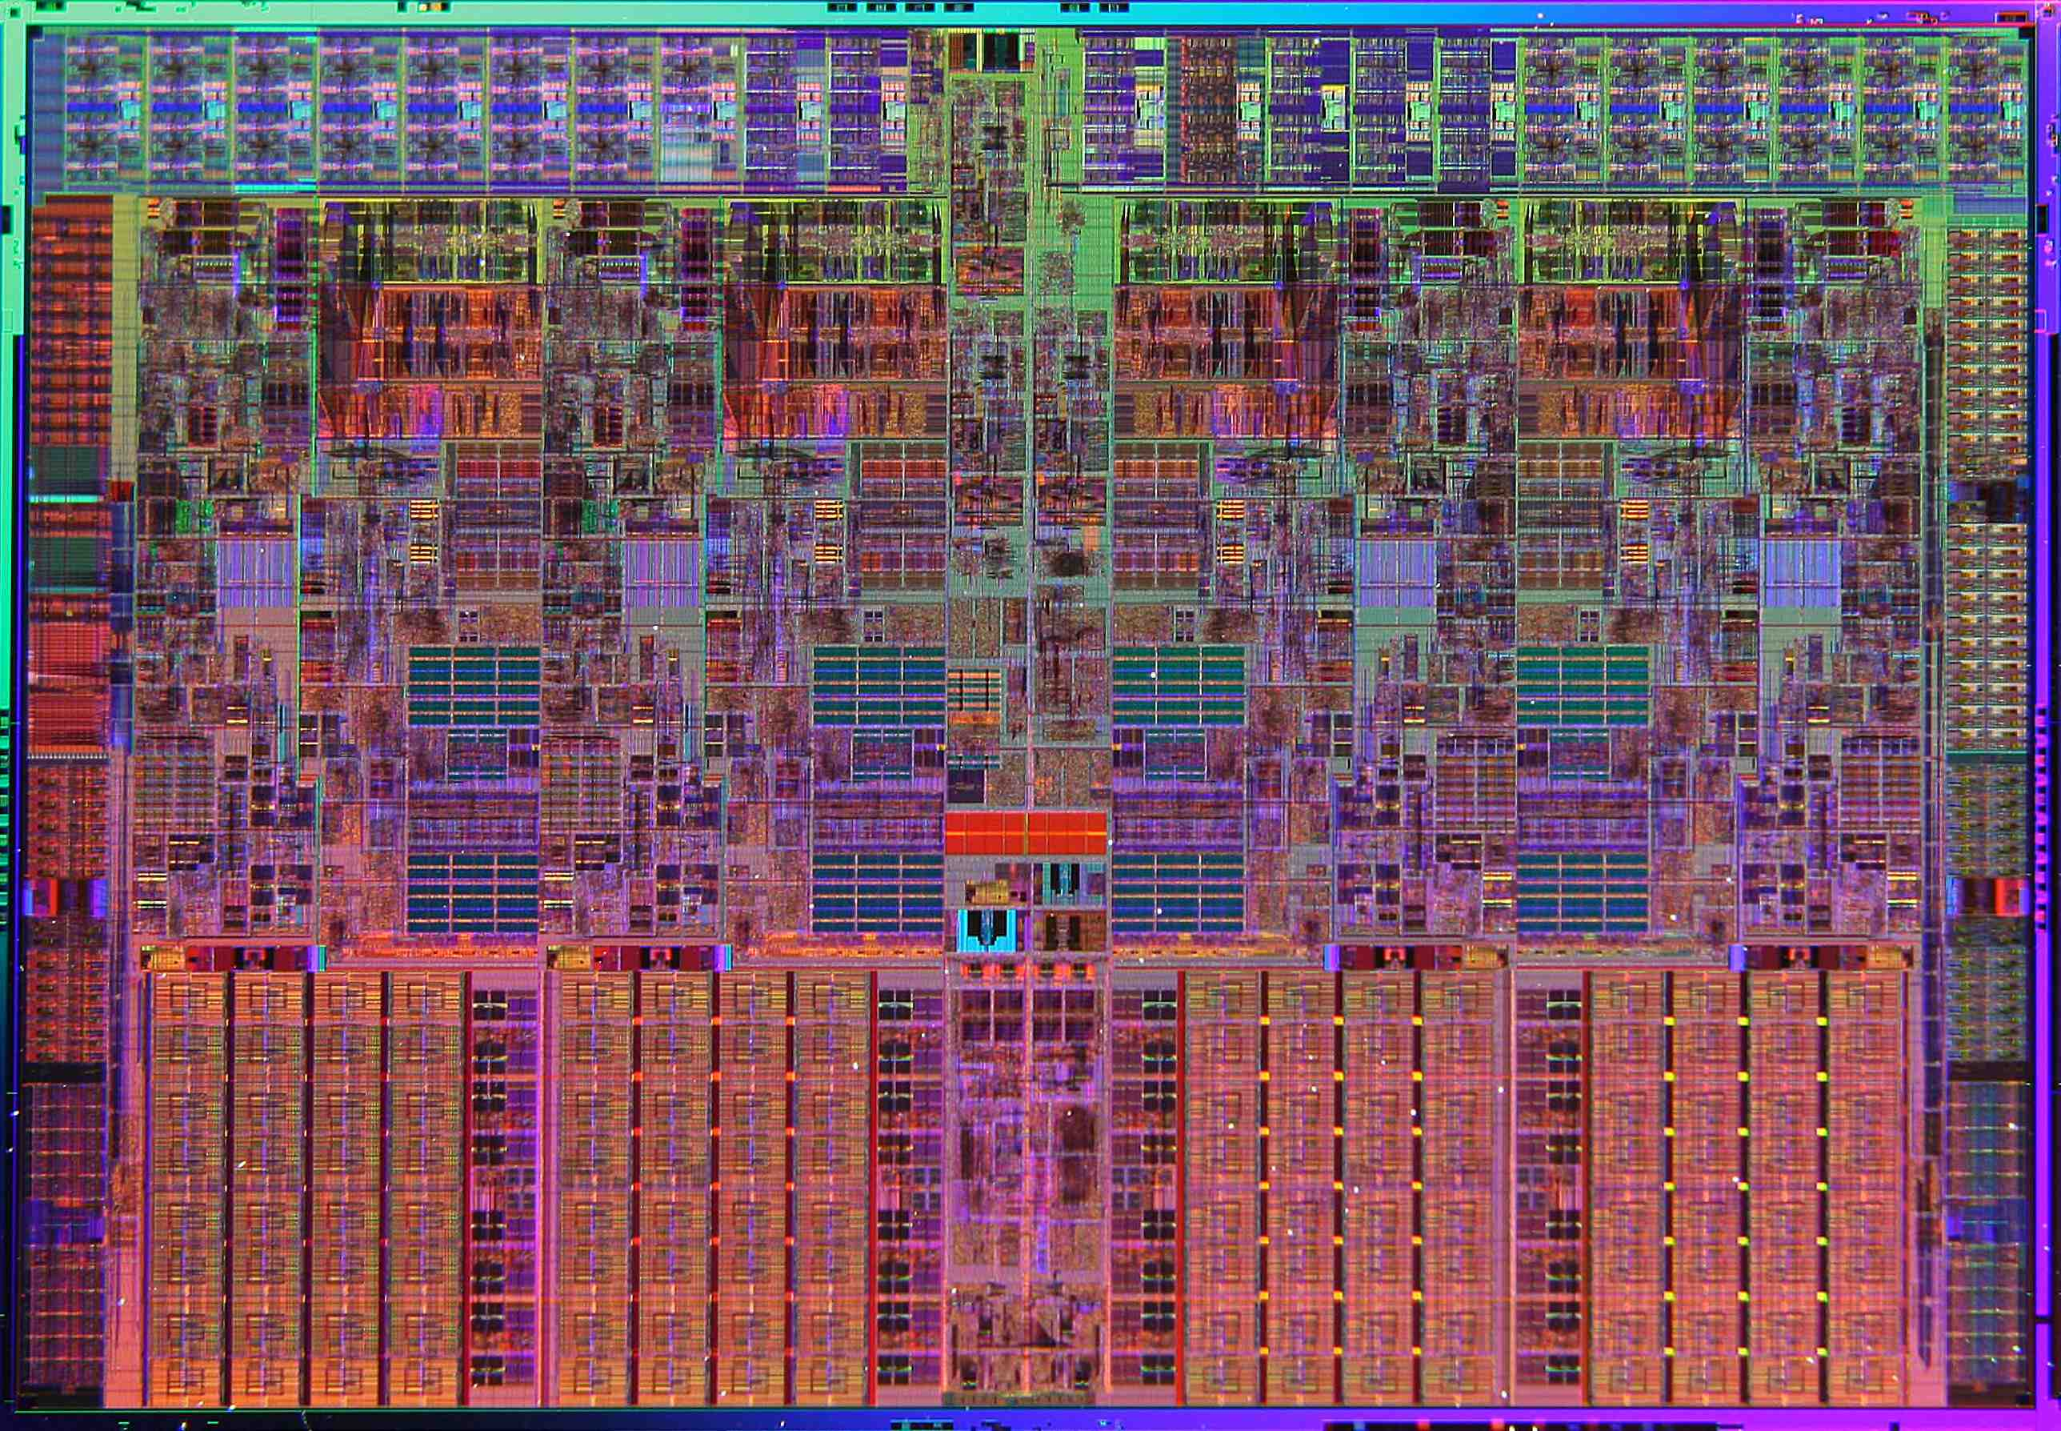
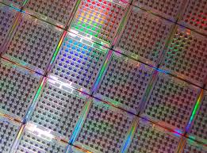
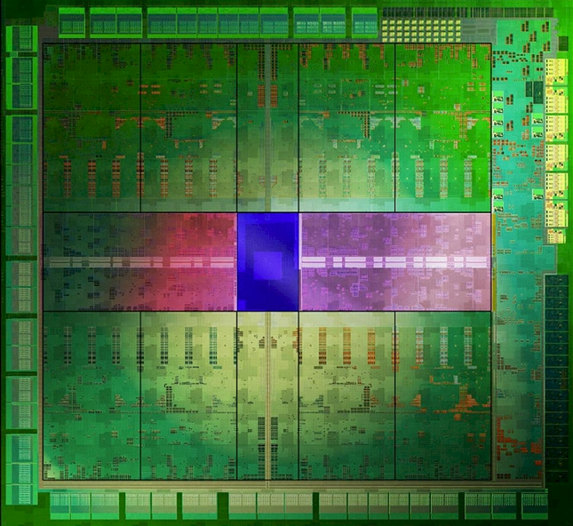
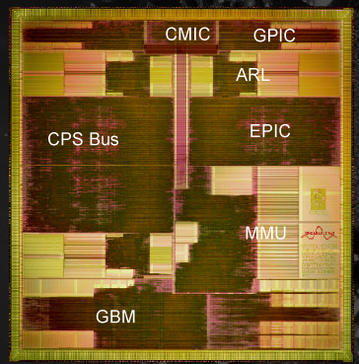
Single Core OoO Superscalar CPU
Better
(how to get here?)
Brawny (OoO) Multicore
Ease of
Programming
Wimpy (In-order) Multicore
16K thread, SIMT Accelerator
ASIC
Hardware Efficiency
Notes:
Approach 1: Start with easy to program hardware and improve HW efficiency
Approach 2: Start with efficient HW and make it easier to program

Slide 82
Start by using right tool for each job…
Ease of
Programming
Hardware Efficiency
Notes:
Approach 1: Start with easy to program hardware and improve HW efficiency
Approach 2: Start with efficient HW and make it easier to program

Slide 83
Amdahl’s Law Limits this Approach
Hard to accelerate
Easy to accelerate

Slide 84
Question: Can dividing line be moved?
easy to accelerate (Acc. Arch1)
easy to accelerate (Acc. Arch2)

Slide 85
Forward-Looking GPU Software
Still Massively Parallel
Less Structured
Memory access and control flow patterns are less predictable
Less efficient on today’s GPU
Molecular Dynamics
Raytracing
Execute efficiently on a GPU today
Object Classification
Graphics Shaders
…
…
Matrix Multiply

Slide 86
Two Routes to “Better”
Better
Ease of
Programming
Energy Efficiency
Notes:
Approach 1: Start with easy to program hardware and improve HW efficiency
Approach 2: Start with efficient HW and make it easier to program

Slide 87
Research Direction 1: Mitigating SIMT Control Divergence

Slide 88
Recall: SIMT Hardware Stack
Stack
A
A/1111
Reconv. PC
Next PC
Active Mask
TOS
TOS
TOS
TOS
-
-
-
-
-
-
-
G
A
E
E
B
E
E
1111
1111
1111
1111
1111
1111
1111
E
E
D
D
0110
TOS
E
D
0110
0110
B
B/1111
TOS
TOS
E
E
C
E
1001
1001
C/1001
D/0110
C
D
F
Thread Warp
Common PC
E
E/1111
Thread
1
Thread
2
Thread
3
Thread
4
G
G/1111
A
B
C
D
E
G
A
Time
Potential for significant loss of throughput when control flow diverged!

Slide 89
Performance vs. Warp Size
165 Applications
Convergent Applications
Warp-Size Insensitive Applications
Divergent Applications

Slide 90
Dynamic Warp Formation (Fung MICRO’07)
Warp 0
Warp 1
Warp 2
A
1 2 3 4
Reissue/Memory
Latency
A
5 6 7 8
A
9 10 11 12
B
1 2 3 4
B
5 6 7 8
B
9 10 11 12
SIMD Efficiency → 88%
C
1 2 -- --
Pack
C
1 2 7 8
Time
C
5 -- 7 8
C
5 -- 11 12
C
-- -- 11 12
D
-- -- 3 4
How to pick threads to pack into warps?
D
-- 6 -- --
D
9 10 -- --
E
1 2 3 4
E
5 6 7 8
E
9 10 11 12
Notes:
Multiple warps interleave execution in core to hide pipeline/memory latency
Breaks up the “static warps”, pack the threads running this instruction into fewer warps to improve efficiency
How should we decide which threads to pack together?

Slide 91
Dynamic Warp Formation: Hardware Implementation
A: BEQ R2, B
C: …
Thread Scheduler
PC-Warp LUT
Warp Pool
I
s
Warp Update Register T
B
s
B
0110
0010
0
2
A
B
B
1
5
2
2
2
3
3
3
4
PC
OCC
IDX
PC
TID x N
8
Prio
u
TID x N
e
5
2
7
3
8
1011
0110
B
REQ
B
PC A
H
C
C
1001
1101
1
1
A
C
PC
OCC
IDX
C
PC
TID x N
Prio
5
1
6
6
7
8
4
L
Warp Update Register NT
B
o
PC
TID x N
Prio
g
7
i
1
6
4
0100
c
1001
C
TID x N
REQ
C
PC B
H
X
Warp Allocator
Y
X
Y
X
Y
Z
X
Y
Z
X
Y
Z
1
5
1
5
1
5
5
1
5
5
1
5
5
2
6
2
6
2
6
2
2
6
2
2
6
2
3
7
3
7
3
7
3
3
7
3
3
7
3
4
8
4
8
4
8
8
4
8
8
4
8
8
No Lane Conflict

Slide 92
DWF Pathologies: Starvation
B: if (K > 10)
C: K = 10;
else
D: K = 0;
E: B = C[tid.x] + K;
Majority Scheduling
Best Performing
Prioritize largest group of threads with same PC
Starvation
LOWER SIMD Efficiency!
Other Warp Scheduler?
Tricky: Variable Memory Latency
C
1 2 7 8
C
5 -- 11 12
D
E
9 6 3 4
1 2 7 8
D
E
-- 10 -- --
5 -- 11 12
E
1 2 3 4
1000s cycles
E
5 6 7 8
D
9 6 3 4
E
9 10 11 12
D
-- 10 -- --
Time
E
9 6 3 4
E
-- 10 -- --
Notes:
12:17 – 13:00 – 14:23

Slide 93
DWF Pathologies: Extra Uncoalesced Accesses
Coalesced Memory Access = Memory SIMD
1st Order CUDA Programmer Optimization
Not preserved by DWF
E: B = C[tid.x] + K;
#Acc = 3
Memory
No DWF
E
1 2 3 4
0x100
E
5 6 7 8
0x140
E
9 10 11 12
0x180
L1 Cache Absorbs
Redundant
Memory Traffic
#Acc = 9
Memory
With DWF
E
1 2 7 12
0x100
E
9 6 3 8
0x140
L1$ Port Conflict
E
5 10 11 4
0x180
Notes:
14:23 – 16:15
Coalesced Memory Access = Grouping individual word accesses from threads inside a warp into a wide access to a chunk of memory
- Serviced by a single wide access

Slide 94
DWF Pathologies: Implicit Warp Sync.
Some CUDA applications depend on the lockstep execution of “static warps”
E.g. Task Queue in Ray Tracing
Warp 0
Thread 0 ... 31
Warp 1
Thread 32 ... 63
Warp 2
Thread 64 ... 95
int wid = tid.x / 32;
if (tid.x % 32 == 0) {
sharedTaskID[wid] = atomicAdd(g_TaskID, 32);
}
my_TaskID = sharedTaskID[wid] + tid.x % 32;
ProcessTask(my_TaskID);
Implicit
Warp
Sync.
Notes:
16:15 – 17:22
A single thread in each warp branches off to fetch task for the rest of the warp.

Slide 95
Observation
Compute kernels usually contain divergent and non-divergent (coherent) code segments
Coalesced memory access usually in coherent code segments
DWF no benefit there
Coherent
Static
Warp
Divergence
Divergent
Dynamic
Warp
Recvg
Pt.
Reset Warps
Coherent
Static
Warp
Coales. LD/ST
Notes:
17:22 – 18:37

Slide 96
Thread Block Compaction
Run a thread block like a warp
Whole block move between coherent/divergent code
Block-wide stack to track exec. paths reconvg.
Barrier @ Branch/reconverge pt.
All avail. threads arrive at branch
Insensitive to warp scheduling
Warp compaction
Regrouping with all avail. threads
If no divergence, gives static warp arrangement
Implicit
Warp Sync.
Starvation
Extra Uncoalesced
Memory Access
Notes:
18:37 – 20:03

Slide 97
Thread Block Compaction
PC
RPC
Active Threads
A
1 2 3 4
A
1 2 3 4
A
E
-
-
1
1
2
2
3
3
4
4
5
5
6
6
7
7
8
8
9
9
10
10
11
11
12
12
A
5 6 7 8
A
5 6 7 8
D
E
--
--
--
--
3
--
4
--
--
--
6
--
--
--
--
--
9
--
10
--
--
--
--
--
A
9 10 11 12
A
9 10 11 12
C
E
1
--
2
--
--
--
--
--
5
--
--
--
7
--
8
--
--
--
--
--
11
--
12
--
A: K = A[tid.x];
B: if (K > 10)
C: K = 10;
else
D: K = 0;
E: B = C[tid.x] + K;
C
1 2 7 8
C
1 2 -- --
C
5 -- 11 12
C
5 -- 7 8
D
9 6 3 4
C
-- -- 11 12
D
-- 10 -- --
D
-- -- 3 4
E
1 2 3 4
D
-- 6 -- --
E
5 6 7 8
D
9 10 -- --
E
9 10 11 12
E
1 2 7 8
E
5 6 7 8
E
9 10 11 12
Time
Notes:
20:03 – 21:45
Here is the same example as before with the block-wide stack.
Clarify that in HW, the active threads are represented as a block-wide active mask.

Slide 98
Thread Compactor
Convert activemask from block-wide stack to thread IDs in warp buffer
Array of Priority-Encoder
C
E
1
2
--
--
5
--
7
8
--
--
11
12
1
5
--
2
--
--
--
7
11
--
8
12
P-Enc
P-Enc
P-Enc
P-Enc
1
5
2
--
7
11
8
12
Warp Buffer
C
1 2 7 8
C
5 -- 11 12

Slide 99
Experimental Results
2 Benchmark Groups:
COHE = Non-Divergent CUDA applications
DIVG = Divergent CUDA applications
COHE
Serious Slowdown from
pathologies
DWF
DIVG
No Penalty for COHE
TBC
22% Speedup on DIVG
0.6
0.7
0.8
0.9
1
1.1
1.2
1.3
IPC Relative to Baseline
Per-Warp Stack
Notes:
26:53 – 27:50
We group our benchmarks according to how much they suffer from branch divergence in the first place.

Slide 100
Recent work on warp divergence
Intel [MICRO 2011]: Thread Frontiers – early reconvergence for unstructured control flow.
UT-Austin/NVIDIA [MICRO 2011]: Large Warps – similar to TBC except decouple size of thread stack from thread block size.
NVIDIA [ISCA 2012]: Simultaneous branch and warp interweaving. Enable SIMD to execute two paths at once.
Intel [ISCA 2013]: Intra-warp compaction – extends Xeon Phi uarch to enable compaction.
NVIDIA: Temporal SIMT [described briefly in IEEE Micro article and in more detail in CGO 2013 paper]
NVIDIA [ISCA 2015]: Variable Warp-Size Architecture – merge small warps (4 threads) into “gangs”.

Slide 101
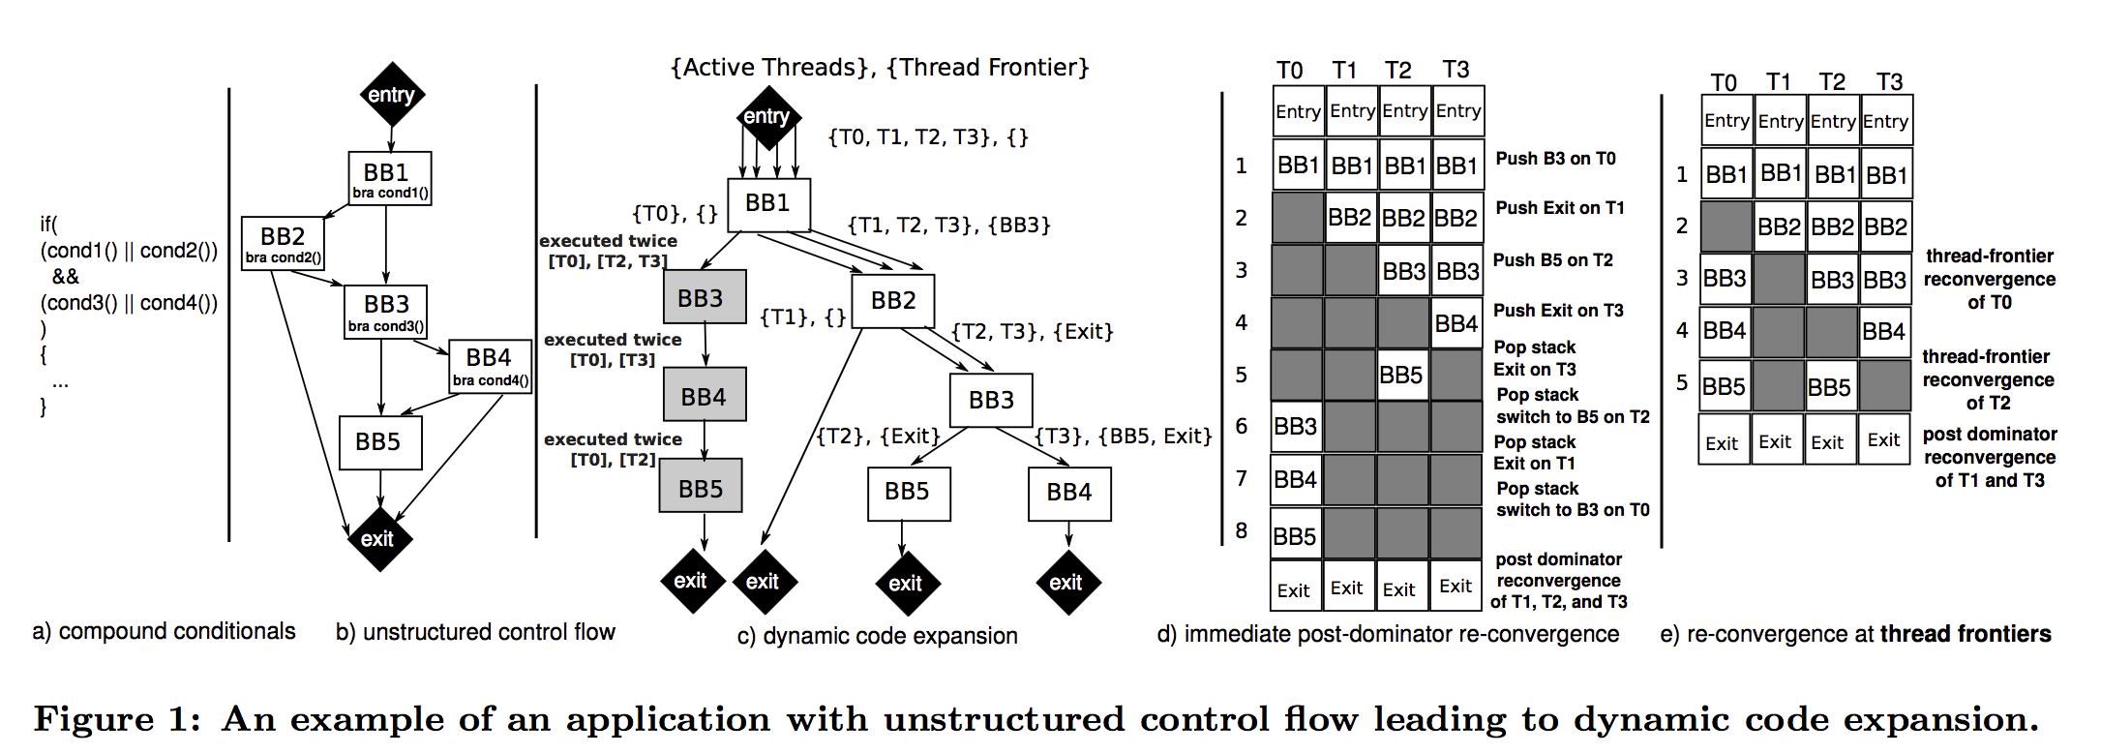
Thread Frontiers [Diamos et al., MICRO 2011]
+

Slide 102
Temporal SIMT
Spatial SIMT (current GPUs)
Pure Temporal SIMT
32-wide datapath
1-wide
thread
0
thread
31
(threads)
time
1 cyc
time
ld
ld
ld
ld
ld
ld
ld
ld
ld
ld
ld
ld
ld
ld
ld
ld
ld
ld
ld
ld
ld
ld
ld
ld
ld
ld
ld
ld
ld
ld
ld
ld
1 cyc
ld
0
ld
ld
ld
ld
ld
ld
ld
ld
ld
ld
ld
ld
ld
ld
ld
ld
ld
ld
ld
ld
ld
ld
ld
ld
ld
ld
ld
ld
ld
ld
ld
ld
ld
1
ml
ml
ml
ml
ml
ml
ml
ml
ml
ml
ml
ml
ml
ml
ml
ml
ml
ml
ml
ml
ml
ml
ml
ml
ml
ml
ml
ml
ml
ml
ml
ml
ld
2
ad
ad
ad
ad
ad
ad
ad
ad
ad
ad
ad
ad
ad
ad
ad
ad
ad
ad
ad
ad
ad
ad
ad
ad
ad
ad
ad
ad
ad
ad
ad
ad
ld
3
st
st
st
st
st
st
st
st
st
st
st
st
st
st
st
st
st
st
st
st
st
st
st
st
st
st
st
st
st
st
st
st
ld
4
ld
5
1 warp instruction = 32 threads
ld
6
ld
7
ld
8
ld
9
ld
10
[slide courtesy of Bill Dally]

Slide 103
Temporal SIMT Optimizations
Control divergence — hybrid MIMD/SIMT
Scalarization
Factor common instructions from multiple threads
Execute once – place results in common registers
[See: SIMT Affine Value Structure (ISCA 2013)]
32-wide
(41%)
4-wide
(65%)
1-wide
(100%)
[slide courtesy of Bill Dally]

Slide 104
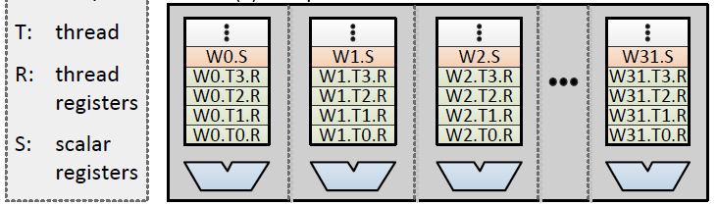
Scalar Instructions in SIMT Lanes
Scalar instruction spanning warp
Scalar register visible to all threads
Temporal execution of Warp
Multiple lanes/warps
[slide courtesy of Bill Dally]
Y. Lee, CGO 2013

Slide 105
Variable Warp-Size Architecture
Most recent work by NVIDIA [ISCA 2015]
Split the SM datapath into narrow slices.
Extensively studied 4-thread slices
Gang slice execution to gain efficiencies of wider warp.
Slices share an L1
I-Cache and Memory Unit
Slices can execute independently

Slide 106
Divergent Application Performance
Warp Size 4
I-VWS: Break on CF Only
E-VWS: Break + Reform

Slide 107
Convergent Application Performance
E-VWS: Break + Reform
I-VWS: Break on CF Only
Warp Size 4
Warp-Size Insensitive Applications Unaffected

Slide 108
Research Direction 2: Mitigating High GPGPU Memory Bandwidth Demands

Slide 109
Reducing Off-Chip Access / Divergence
Re-writing software to use “shared memory” and avoid uncoalesced global accesses is bane of GPU programmer existence.
Recent GPUs introduce caches, but large number of warps/wavefronts lead to thrashing.

Slide 110
NVIDIA: Register file cache (ISCA 2011, MICRO)
Register file burns significant energy
Many values read once soon after written
Small register file cache captures locality and saves energy but does not help performance
Recent follow on work from academia
Prefetching (Kim, MICRO 2010)
Interconnect (Bakhoda, MICRO 2010)
Lee & Kim (HPCA 2012) CPU/GPU cache sharing

Slide 111

Thread Scheduling Analogy [MICRO 2012]
Human Multitasking
Humans have limited attention capacity
GPUs have limited cache capacity
GPU Core
Processor
Cache

Slide 112
Use Memory System Feedback [MICRO 2012]
Cache Misses
Performance
GPU Core
Thread Scheduler
Processor
Cache
Feedback

Slide 113
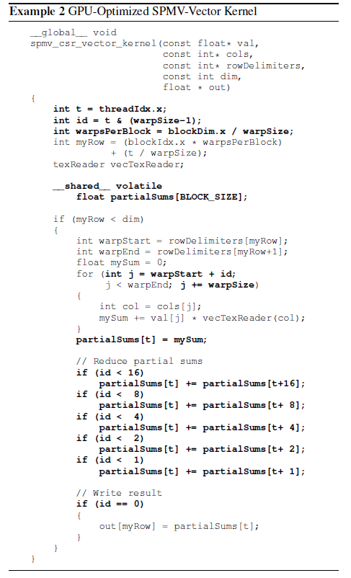
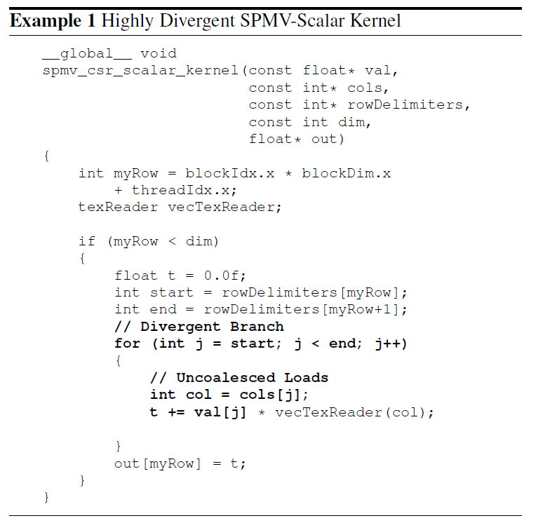


Programmability case study [MICRO 2013]
Sparse Vector-Matrix Multiply
GPU-Optimized Version
SHOC Benchmark Suite
(Oakridge National Labs)
Simple Version
Divergence
Explicit Scratchpad Use
Dependent on Warp Size
Added Complication
Each thread has locality
Parallel Reduction
Using DAWS scheduling
within 4% of optimized with no programmer input

Slide 114
Sources of Locality
Intra-wavefront locality
Inter-wavefront locality
Wave₀
Wave₁
Wave₀
LD $line (X)
LD $line (X)
LD $line (X)
LD $line (X)
Hit
Hit
Data Cache
Data Cache

Slide 115
120
Misses PKI
100
Inter-Wavefront Hits PKI
80
(Hits/Miss) PKI
60
40
Intra-Wavefront Hits PKI
20
0
AVG-Highly Cache Sensitive

Slide 116
Scheduler affects access pattern
Round Robin Scheduler
Greedy then Oldest Scheduler
Wave₀
Wave₁
Wave₀
Wave₁
Wavefront Scheduler
Wavefront Scheduler
ld A
,B,C,D…
ld Z,Y,X,W
ld A,B,C,D…
...
...
...
DC
B
A
WX
Y
Z
ld A,B,C,D
ld Z,Y,X,W
ld A,B,C,D…
DC
B
A
DC
B
A
Memory System
Memory System

Slide 117
Use scheduler to shape access pattern
Cache-Conscious Wavefront Scheduling
[MICRO 2012 best paper runner up,
Top Picks 2013, CACM Research Highlight]
Greedy then Oldest Scheduler
Wave₀
Wave₁
Wave₀
Wave₁
Wavefront Scheduler
Wavefront Scheduler
ld A,B,C,D
ld Z,Y,X,W
ld A,B,C,D…
ld Z,Y,X,W…
...
...
DC
B
A
WX
Y
Z
ld A,B,C,D
ld A,B,C,D…
DC
B
A
DC
B
A
Memory System
Memory System

Slide 118
W₂
No W₂ loads
W₂
W₂
W₁
Wave Scheduler
Locality Scoring System
W₁
Score
W₁
W₀
W₀: ld X
W₀
W₀: ld X
W₂: ld Y
W₀
…
Memory Unit
Time
Cache
W₀ detected lost locality
Tag
Y
WID
X
2
Data
0
…
Tag
WID
Data
Victim Tags
W₀,X
W₀
ProbeW₀,X
Tag
X
Tag
W₁
Tag
Tag
W₂
Tag
Tag

Slide 119
2
LRR
GTO
CCWS
1.5
Speedup
1
0.5
0
HMEAN-Highly Cache-Sensitive
Notes:
A 2-LVL scheduler
Similar to GTO performance
A profile-based oracle scheduler
Application and input data dependent
CCWS captures 86% of oracle scheduler performance
Variety of cache-insensitive benchmarks
No performance degradation

Slide 120
Static Wavefront Limiting [Rogers et al., MICRO 2012]
Profiling an application we can find an optimal number of wavefronts to execute
Does a little better than CCWS.
Limitations: Requires profiling, input dependent, does not exploit phase behavior.

Slide 121
Improve upon CCWS?
CCWS detects bad scheduling decisions and avoids them in future.
Would be better if we could “think ahead” / “be proactive” instead of “being reactive”

Slide 122
Observations [Rogers et al., MICRO 2013]
Memory divergence in static instructions is predictable
Data touched by divergent loads dependent on active mask
Main Memory
Divergence
…
load
…
Warp 1
Warp 0
Both Used To Create Cache Footprint Prediction
Main Memory
Main Memory
4 accesses
2 accesses
Warp
Divergence
Warp
Divergence
1
1
1
1
1
0
0
1

Slide 123
Footprint Prediction
Detect loops with locality
Classify loads in the loop
Compute footprint from active mask
Some loops have locality
Some don’t
Limit multithreading here
Loop with locality
while(…) {
load 1
…
load 2
}
Diverged
Not Diverged
Loop with locality
Warp 0
while(…) {
load 1
…
load 2
}
1
1
1
1
1
1
4 accesses
Diverged
Warp 0’s Footprint
= 5 cache lines
+
Not Diverged
1 access

Slide 124
DAWS Operation Example
Cache
Cache
Cache
Example Compressed Sparse Row Kernel
A[0]
Hit
A[0]
Hit x30
A[32]
int C[]={0,64,96,128,160,160,192,224,256};
void sum_row_csr(float* A, …) {
float sum = 0;
int i =C[tid];
while(i < C[tid+1]) {
sum += A[ i ];
++i;
}
…
A[64]
Hit
A[64]
Hit x30
A[160]
A[96]
Hit
A[96]
Hit x30
A[192]
A[128]
Hit
A[128]
Hit x30
A[224]
Stop
Loop
1st Iter.
Go
Warp₁
Divergent Branch
0
1
1
1
Memory Divergence
Warp₀
1
1
1
1
Warp₀
1
0
0
0
2nd Iter.
Go
33rd Iter.
Go
Go
Time₀
Time₁
Time₂
Cache Footprint
Stop
Warp₁
Early warps profile loop for later warps
Warp 0 has branch divergence
Locality Detected
1 Diverged Load Detected
4
4
4
Footprint = 3X1
Want to capture spatial locality
No locality detected = no footprint
Warp₀
Warp₁
Both warps capture spatial locality together
No Footprint
4 Active threads
Footprint decreased
Footprint = 4X1
Warp₀

Slide 125
Sparse MM Case Study Results
Performance (normalized to optimized version)
Within 4% of optimized with no programmer input
Divergent Code Execution time

Slide 126
Memory Request Prioritization Buffer [Jia et al., HPCA 2014]
W3
W2
W1
W3
W2
W1
W2
W2
W1
W1
Reorder requests by warp ID
W3
W3
Bypass accesses to hot set
Reorder requests by sorting by Warp ID.
Bypass when too many accesses to same cache set.

Slide 127
Priority-Based Cache Allocation in Throughput Processors [Li et al., HPCA 2015]
CCWS leaves L2 and DRAM underutilized.
Allow some additional warps to execute but do not allow them to allocate space in cache:
Warp 0
Normal Warps
Schedule and allocate in L1
Warp 1
Warp 2
Non-Polluting
Warps
Warp 3
Schedule and bypass L1
Warp 4
Warp 5
Throttled Warps
Not scheduled
Warp n-1

Slide 128
Coordinated criticality-Aware Warp Acceleration (CAWA) [Lee et al., ISCA 2015]
Some warps execute longer than others due to lack of uniformity in underlying workload.
Give these warps more space in cache and more scheduling slots.
Estimate critical path by observing amount of branch divergence and memory stalls.
Also, predict if line inserted in line will be used by a warp that is critical using modified version of SHiP cache replacement algorithm.

Slide 129
Other Memory System Performance Considerations
TLB Design for GPUs.
Current GPUs have translation look aside buffers (makes managing multiple graphics application surfaces easier; does not support paging)
How does large number of threads impact TLB design?
E.g., Power et al., Supporting x86-64 Address Translation for 100s of GPU Lanes, HPCA 2014. Importance of multithreaded page table walker + page walk cache.

Slide 130
Research Direction 3: Coherent Memory for Accelerators

Slide 131
Why GPU Coding Difficult?
Manual data movement CPU ⬄ GPU
Lack of generic I/O , system support on GPU
Need for performance tuning to reduce
off-chip accesses
memory divergence
control divergence
For complex algorithms, synchronization
Non-deterministic behavior for buggy code
Lack of good performance analysis tools

Slide 132
Manual CPU ⬄ GPU Data Movement
Problem #1: Programmer needs to identify data needed in a kernel and insert calls to move it to GPU
Problem #2: Pointer on CPU does not work on GPU since different address spaces
Problem #3: Bandwidth connecting CPU and GPU is order of magnitude smaller than GPU off-chip
Problem #4: Latency to transfer data from CPU to GPU is order of magnitude higher than GPU off-chip
Problem #5: Size of GPU DRAM memory much smaller than size of CPU main memory

Slide 133
Identifying data to move CPU ⬄ GPU
CUDA/OpenCL: Job of programmer ☹
C++AMP passes job to compiler.
OpenACC uses pragmas to indicate loops that should be offloaded to GPU.

Slide 134
Memory Model
Rapid change (making programming easier)
Late 1990’s: fixed function graphics only
2003: programmable graphics shaders
2006: + global/local/shared (GeForce 8)
2009: + caching of global/local
2011: + unified virtual addressing
2014: + unified memory / coherence

Slide 135
Caching
Scratchpad uses explicit data movement. Extra work. Beneficial when reuse pattern statically predictable.
NVIDIA Fermi / AMD Southern Island add caches for accesses to global memory space.

Slide 136
CPU memory vs. GPU global memory
Prior to CUDA: input data is texture map.
CUDA 1.0 introduces cudaMemcpy
Allows copy of data between CPU memory space to global memory on GPU
Still has problems:
#1: Programmer still has to think about it!
#2: Communicate only at kernel grid boundaries
#3: Different virtual address space
pointer on CPU not a pointer on GPU => cannot easily share complex data structures between CPU and GPU

Slide 137
Fusion / Integrated GPUs
Why integrate?
One chip versus two (cf. Moore’s Law, VLSI)
Latency and bandwidth of communication: shared physical address space, even if off-chip, eliminates copy: AMD Fusion. 1st iteration 2011. Same DRAM
Shared virtual address space? (AMD Kavari 2014)
Reduce latency to spawn kernel means kernel needs to do less to justify cost of launching

Slide 138
CPU Pointer not a GPU Pointer
NVIDIA Unified Virtual Memory partially solves the problem but in a bad way:
GPU kernel reads from CPU memory space
NVIDIA Uniform Memory (CUDA 6) improves by enabling automatic migration of data
Limited academic work. Gelado et al. ASPLOS 2010.

Slide 139
CPU ⬄ GPU Bandwidth
Shared DRAM as found in AMD Fusion (recent Core i7) enables the elimination of copies from CPU to GPU. Painful coding as of 2013.
One question how much benefit versus good coding. Our limit study (WDDD 2008) found only ~50% gain. Lustig & Martonosi HPCA 2013.
Algorithm design—MummerGPU++

Slide 140
CPU ⬄ GPU Latency
NVIDIA’s solution: CUDA Streams. Overlap GPU kernel computation with memory transfer. Stream = ordered sequence of data movement commands and kernels. Streams scheduled independently. Very painful programming.
Academic work: Limit Study (WDDD 2008), Lustig & Martonosi HPCA 2013, Compiler data movement (August, PLDI 2011).

Slide 141
GPU Memory Size
CUDA Streams
Academic work: Treat GPU memory as cache on CPU memory (Kim et al., ScaleGPU, IEEE CAL early access).

Slide 142
Solution to all these sub-issues?
Heterogeneous System Architecture: Integrated CPU and GPU with coherence memory address space.
Need to figure out how to provide coherence between CPU and GPU.
Really two problems: Coherence within GPU and then between CPU and GPU.

Slide 143
Review: Cache Coherence Problem
P
1
P
2
P
3
u
= ?
u
= ?
3
$
4
$
5
$
u
:5
u
:5
u
= 7
1
I/O devices
u
:5
2
Memory
Processors see different values for u after event 3
With write back caches, value written back to memory depends on order of which cache writes back value first
Unacceptable situation for programmers

Slide 144
Coherence Invariants
Single-Writer, Multiple-Reader (SWMR) Invariant
Data-Value Invariant. The value of the memory location at the start of an epoch is the same as the value of the memory location at the end of its last read-write epoch.
read-write
Core 0
read-only
Core 0,2
read-write
Core 3
read-only
Core 0,3
read-only
Core 0,1,3
C0: store A
C2: load A
C3: store A
C0: load A
C1: load A
Notes:
Definition from: “A Primer on Memory Consistency and Cache Coherence” (an excellent book on the subject if you want to learn more).

Slide 145
Coherence States
How to design system satisfying invariants?
Track “state” of memory block copies and ensure states changes satisfy invariants.
Typical states: “modified”, “shared”, “invalid”.
Mechanism for updating block state called a coherence protocol.

Slide 146
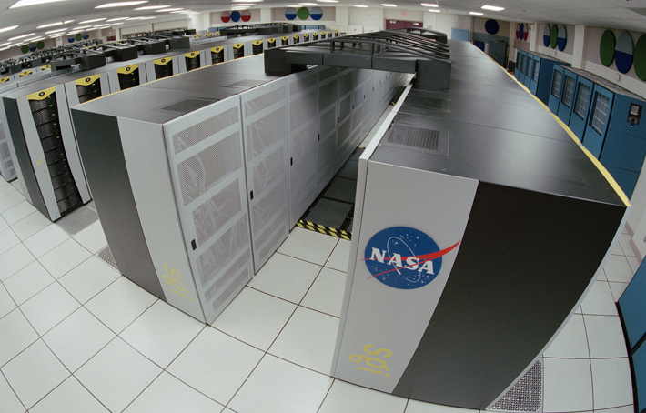
Intra-GPU Coherence
[Singh et al., HPCA 2013, IEEE Micro Top Picks 2014]
Coherent memory space
Efficient critical sections
Load balancing
Stencil computation
lock shared structure
…
computation
…
unlock
Workgroups

Slide 147
GPU Coherence Challenges
Challenge 1: Coherence traffic
Load C
Load D
Load E
Load F
…
Load G
Load H
Load I
Load J
…
Load K
Load L
Load M
Load N
…
Load O
Load P
Load Q
Load R
…
No coherence
MESI
GPU-VI
Load C
2.2
C1
C2
C3
C4
1.5
Recalls
1.3
L1D
L1D
L1D
L1D
A
B
A
B
A
B
A
B
Interconnect traffic
rcl A
rcl A
rcl A
1.0
ack
ack
rcl A
ack
ack
gets C
L2/Directory
0.5
A
B
Do not require
coherence

Slide 148
GPU Coherence Challenges
Challenge 2: Tracking in-flight requests
Significant % of L2
S Shared
S_M
M Modified
L2 / Directory
MSHR

Slide 149
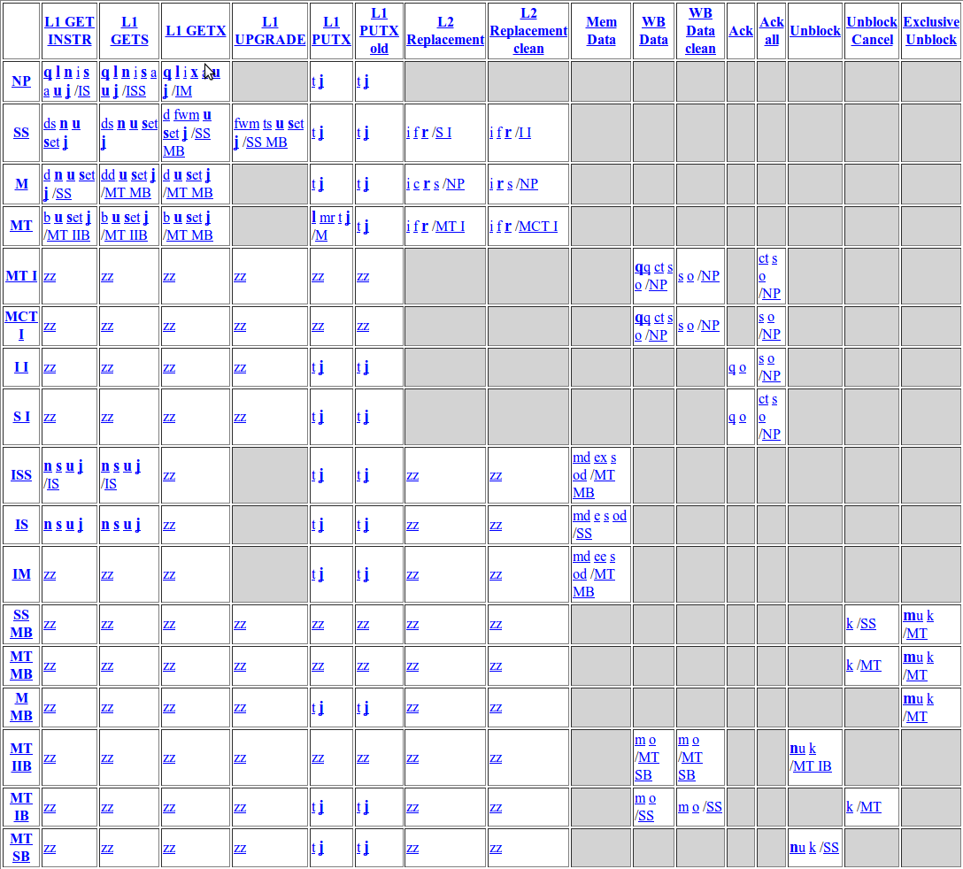
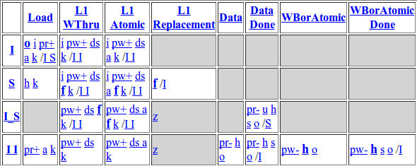
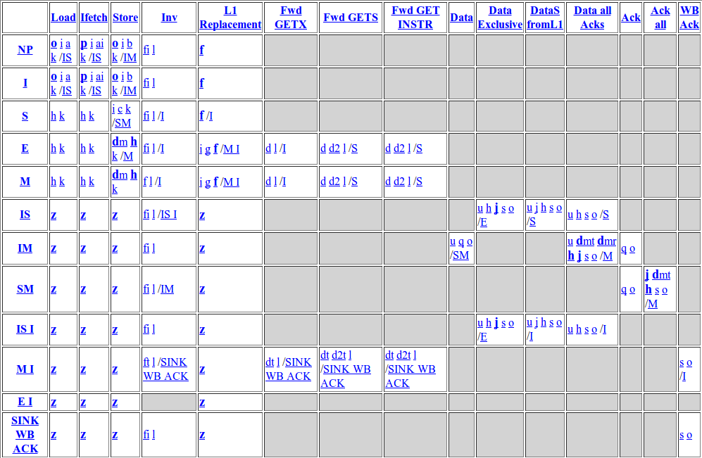
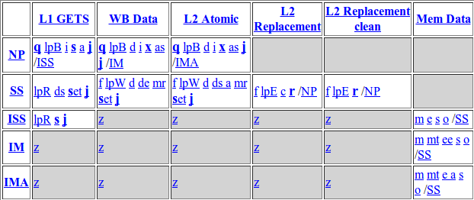
GPU Coherence Challenges
Challenge 3: Complexity
MESI L2 States
Non-coherent L1
MESI L1 States
Events
States
Non-coherent L2

Slide 150
Coherence Challenges
Challenges of introducing coherence messages on a GPU
Traffic: transferring messages
Storage: tracking message
Complexity: managing races between messages
GPU cache coherence without coherence messages?
YES – using global time
Notes:
Turns out they all stem from coherence messages
The traffic overhead was from transferring these messages around
The storage overhead was from tracking them
The complexity overhead was from managing the races between these messages
Next question is, is GPU coherence possible without these messages? YES – using global time

Slide 151

Temporal Coherence
Related: Library Cache Coherence
Local Timestamp
> Global Time → VALID
Global time
Core 1
Core 2
L1D
L1D
▪▪▪
0
A=0
Global Timestamp
< Global Time →
NO L1 COPIES
Interconnect
L2 Bank
▪▪▪
0
A=0
Notes:
We call our protocol Temporal Coherence, or TC for short
At this level of detail, TC looks similar to the recently proposed Library Cache Coherence
TC relies on global system time. One way to implement global time is through synchronized timestamp counters at each component. In fact, current Intel and AMD processors already implement these synchronized counters for other reasons, and TC can simply leverage them
TC also adds a timestamp entry to each L1 cache line called Local Timestamp
This entry will track the time this block is valid until in this L1
So a line is only valid in the L1 if its local timestamp is greater than the current time
It adds a timestamp entry to each L2 cache line called Global Timestamp
This entry will track the time until this block is valid in any of the L1s
So a global timestamp that is less than the current time indicates that none of the L1s have a valid copy of this line

Slide 152

Temporal Coherence Example
T=0
T=11
T=15
Core 1
Core 2
L1D
L1D
No coherence messages
10
A=0
10
A=0
Interconnect
Load A
Store A=1
T=10
L2 Bank
▪▪▪
10
10
0
A=0
A=0
A=1
A=0
Notes:
Let’s take a look at how TC works by going through an example
In this example we start with a line A in the L2
Core 1 issues a load for line A
TC requires that each load request include a request for the block’s lifetime in the L1. Let’s assume Core 1 requests A until time 10
The L2 will updated the global timestamp to accommodate this request, and send the timestamp and data back to Core 1
Core will store both of these in its L1
When time advances to 11, this line self-invalidates in the L1. This event happens implicitly because the next read request will find the local timestamp to be expired
Later, Core 2 wants to write to A. It writes through to the L2
The L2 checks the global timestamp for A and finds that it is less than the current time. This means none of the L1s have it
So the store completes right away without any coherence messages
Notice how by self invalidating a line in the L1, and allowing the L2 to know when this event has occurred allowed TC to have coherence without any messages

Slide 153
+
Performance
NO-L1
MESI
GPU-VI
TC-Weak
2.0
TC-Weak with simple predictor performs 85% better than disabling L1 caches
1.5
Speedup
1.0
0.5
0.0
Require coherence
Notes:
Next let’s look at the performance
This time I’m going to show you the performance for the set of GPU applications that require coherence (highlight inter-workgroup communication)
This means we have to disable the non-coherent L1 caches on our GPU for these applications to work correctly
TC-Weak improves the performance by 85% because it does not have to disable the L1 caches
TC-Weak also performs 28% better than the stalling alternative I discussed earlier
Finally, we observed that larger directory sizes generally do not improve performance
Directory miss latency hurts on a CPU but GPUs are latency tolerant

Slide 154
CPU-GPU Coherence?
Many vendors have introduced chips with both CPU and GPU (e.g., AMD Fusion, Intel Core i7, NVIDIA Tegra, etc…)
What are the challenges with maintaining coherence across CPU and GPU?
One important one: GPU has higher cache miss rate than CPU. Can place pressure on directory impacting performance.
Power et al., Heterogeneous System Coherence for Integrated CPU-GPU Systems, ISCA 2013: Use “region coherence” to reduce number of GPU requests that need to access directory.

Slide 155
Review: Consistency Model
Memory consistency model specifies allowable orderings of loads and stores to different locations
The number of allowable execution orderings generally far greater than one.
Ordering of operations from different processors is non-deterministic. Software must use synchronization (mutexes, semaphores, etc…) to provide determinism.

Slide 156
Sequential Consistency
Sequential consistency is basically a “naïve” programmer’s intuition of allowable orderings:
Notes:
Also, multitasking uniprocessor

Slide 157
Total Store Order (TSO/x86) Memory Model
Use of write (store) buffer considered very important by Intel and AMD for x86.
Leads to total store order memory model supported by x86.
In general, memory model on multicore processors is not sequential consistency.

Slide 158
Example, TSO/x86 ordering
Program order of core C1
Memory order
Program order of core C2
S1: x=NEW /* NEW */
S2: y=NEW /* NEW */
L1: r1=y /* 0 */
L2: r2=x /* 0 */
(r1, r2) = (0, 0) is legal outcome under TSO/x86 (!)

Slide 159
Current GPU Memory Consistency Models?
NVIDIA Fermi: No coherence. Can have stale data in first level data cache (e.g., Barnes Hut example from GPU Gems). “Consistency”: Write from kernel N guaranteed to be visible to load from kernel N+1.
NVIDIA Kepler restricts caching in L1D to global data compiler can prove is read only.
See also: Alglave et al., “GPU Concurrency: Weak Behaviours and Programming Assumptions”, ASPLOS 2015.

Slide 160
Impact of Consistency Model on Performance of GPU Coherence?
[Singh HPCA 2013] Assumes release consistency as do more recent AMD/Wisconsin papers on CPU-GPU coherence
Hechtman and Sorin [ISCA 2013]: large number of threads on GPU may enable one to implement sequential consistency with same performance as more relaxed consistency models.
One caveat: Write back caches in their study versus write through in existing GPUs.

Slide 161
Research Direction 4: Easier Programming with Synchronization

Slide 162
Synchronization
Locks are not encouraged in current GPGPU programming manuals.
Interaction with SIMT stack can easily cause deadlocks:
while( atomicCAS(&lock[a[tid]],0,1) != 0 )
; // deadlock here if a[i] = a[j] for any i,j = tid in warp
// critical section goes here
atomicExch (&lock[a[tid]], 0) ;

Slide 163
Correct way to write critical section for GPGPU:
done = false;
while( !done ) {
if( atomicCAS (&lock[a[tid]], 0 , 1 )==0 ) {
// critical section goes here
atomicExch(&lock[a[tid]], 0 ) ;
}
}
Most current GPGPU programs use barriers within thread blocks and/or lock-free data structures.
This leads to the following picture…

Slide 164
Lifetime of GPU Application Development
Functionality
Performance
E.g. N-Body with 5M bodies CUDA SDK: O(n²) – 1640 s (barrier) Barnes Hut: O(nLogn) – 5.2 s (locks)
Time
Fine-Grained Locking/Lock-Free
Transactional Memory
?
Time
Time
Wilson Fung, Inderpeet Singh, Andrew Brownsword, Tor Aamodt
Notes:
Usually, developers can get the application running on GPU after a little bit of initial effort, and spend the rest of their time tuning the application for performance.
For application that require (or benefit from) fine-grained data synchronization, the developer may spend significant effort just to get the code working. As in the usual case, the first working code performs poorly, so effort to tune the application is still required. If the developers spend the effort to tune the code, the reward can be great. For example, O(nLogn) implementation of N-Body is orders of magnitude faster than the naïve implementation, but it is harder to get right because of locks.
Hypothesis 1: For applications that require fine-grained communication between tasks, developers will give up long before the code is working on a GPU, and even if they manage to get the application to run correctly, the performance will initially be bad and they may then decide they have wasted too much time for too little progress.
Hypothesis 2: With TM, the developer will get working code sooner, leaving time to tune the code for performance.
Even if there is a performance overhead for using TM it is a gain for the developer (better performing code with same effort).

Slide 165
Transactional Memory
Programmer specifies atomic code blocks called transactions [Herlihy’93]
Lock Version:
Lock(X[a]);
Lock(X[b]);
Lock(X[c]);
X[c] = X[a]+X[b];
Unlock(X[c]);
Unlock(X[b]);
Unlock(X[a]);
TM Version:
atomic {
X[c] = X[a]+X[b];
}
Potential Deadlock!

Slide 166
Transactional Memory
Programmers’ View:
TX1
Time
TX2
Time
OR
TX2
TX1
Non-conflicting transactions may run in parallel
Conflicting transactions automatically serialized
Memory
Memory
A
TX1
A
TX1
B
TX2
B
TX2
C
C
Commit
D
Abort
Commit
D
Commit
TX2
Commit
Notes:
In the programmers’ view, transactions are executed atomically in some order.
The underlying runtime system can optimistically run non-conflicting transactions in parallel.
Conflicting transactions may be resolved by aborting one of the transaction and restarting it later.

Slide 167
Are TM and GPUs Incompatible?
GPU uarch very different from multicore CPU…
KILO TM [MICRO’11, IEEE Micro Top Picks]
Hardware TM for GPUs
Half performance of fine grained locking
Chip area overhead of 0.5%
Hardware TM for GPU Architectures
167
Notes:
For those who know something about both TM and GPU, the two may seem to be incompatible concepts.
Yes, GPUs are different from multi core CPUs.
These differences lead to a set of challenges for supporting TM on GPU.
For each of these challenges, I will show you how KILO TM, our hardware TM for GPUs, addresses the challenge.

Slide 168
Hardware TM for GPUs Challenge #1: SIMD Hardware
On GPUs, scalar threads in a warp/wavefront execute in lockstep
A Warp with 4 Scalar Threads
...
TxBegin
LD r2,[B]
ADD r2,r2,2
ST r2,[A]
TxCommit
...
T0
T1
T2
T3
T0
T1
T2
T3
Branch Divergence!
Committed
T0
T1
T2
T3
Aborted
Hardware TM for GPU Architectures
168
Notes:
GPU use SIMD hardware. Programmer writes code assuming scalar threads. This leads to single instruction, multiple thread (SIMT) programming model. SIMT = MIMD programming model on SIMD hardware.
Threads are executed in lockstep on SIMD hardware as warps.
Since data access pattern of each thread can be different, individual threads may commit or abort at TxCommit.
The threads that managed to commit will want to move on, whereas the threads that were aborted need to restart the transaction.
This is essentially a branch divergence.

Slide 169
KILO TM – Solution to Challenge #1: SIMD Hardware
Transaction Abort
Like a Loop
Extend SIMT Stack
...
TxBegin
LD r2,[B]
ADD r2,r2,2
ST r2,[A]
TxCommit
...
Abort
Wilson Fung, Inderpeet Singh, Andrew Brownsword, Tor Aamodt
169
Hardware TM for GPU Architectures
169
Hardware TM for GPU Architectures
Notes:
169
In KILO TM, we observed that transactions normally aborts at the end of the transaction, so an abort would act like a loop.
This is similar branch divergence with loops.
We have extended the SIMT Stack, a hardware structure to handle branch divergence, to treat transactions like a loop.

Slide 170
Hardware TM for GPUs Challenge #2: Transaction Rollback
GPU Core (SM)
CPU Core
10s of
Registers
Warp
32k Registers
Warp
Warp
Register File
Warp
Warp
Warp
Warp
Register
File
@ TX
Abort
@ TX
Entry
Warp
Checkpoint
Register File
2MB Total
On-Chip Storage
Checkpoint?
Hardware TM for GPU Architectures
170
Notes:
It is cheap to take a register checkpoint on a CPU core with 10s of register.
On a GPU there are 1000s of registers per core, across the chip this amounts to 2MB. Checkpointing this is not trivial, if not impossible.

Slide 171
KILO TM – Solution to Challenge #2: Transaction Rollback
SW Register Checkpoint
Most TX: Reg overwritten first appearance (idempotent)
TX in Barnes Hut: Checkpoint 2 registers
Overwritten
TxBegin
LD r2,[B]
ADD r2,r2,2
ST r2,[A]
TxCommit
Abort
Hardware TM for GPU Architectures
171
Notes:
We have made observations similar to folks who worked on the idempotent points (work published at MICRO-44 concurrently with our paper).
The example transaction shows:
The register R2 is overwritten right away, so there is no point in restoring its original value.
We do observe that one of the more complex transactions in Barnes Hut needs to checkpoint 2 registers.
Using software to checkpoint these few registers in this uncommon case should not incur much overhead.

Slide 172
Hardware TM for GPUs Challenge #3: Conflict Detection
Existing HTMs use Cache Coherence Protocol
Not Available on (current) GPUs
No Private Data Cache per Thread
Signatures?
1024-bit / Thread
3.8MB / 30k Threads
Hardware TM for GPU Architectures
172
Notes:
Next 2 challenges are presented in a row. They are solved with a common solution.
A key challenge to support hardware TM for GPUs: Identifying conflicts among 30k concurrent threads.
How do we detect read-write conflict?
Cache coherence?
But, GPU does not have coherence, nor it has private data cache for each thread!
Transactions can use signatures to record the read-set and write-set instead.
We had to use 1024-bit signature per thread to encode the read-set and write-set with reasonable accuracy.
The signature storage is so large that we give up on the idea.

Slide 173
Hardware TM for GPUs Challenge #4: Write Buffer
GPU Core (SM)
Warp
L1 Data Cache
Warp
Warp
Warp
Warp
Warp
Warp
Problem: 384 lines / 1536 threads < 1 line per thread!
1024-1536 Threads
Fermi’s L1 Data Cache
(48kB)
= 384 X 128B Lines
Hardware TM for GPU Architectures
173

Slide 174
KILO TM: Value-Based Conflict Detection
Global
Memory
A=1
A=1
TX1
atomic
{B=A+1}
Private Memory
B=0
B=2
Read-Log
A=1
TxBegin
LD r1,[A]
ADD r1,r1,1
ST r1,[B]
TxCommit
Write-Log
B=2
TX2
atomic
{A=B+2}
B=2
Private Memory
Read-Log
TxBegin
LD r2,[B]
ADD r2,r2,2
ST r2,[A]
TxCommit
B=0
Write-Log
A=2
Self-Validation + Abort:
Only detects existence of conflict (not identity)
Hardware TM for GPU Architectures
174
Notes:
This transaction (TX1) does B=A+1. As the transaction executes, it populates the read-log with both address and value of each load, and similarly for each store.
The conflict detection is done by reading from global memory.
What I didn’t show you is that there is another transaction Tx 2 running in parallel. reading B, writes to A.
There is a race condition because Tx1 had updated B. Here is how do we detect this race condition.
The beauty of this mechanism is that each transaction only detects the existance of conflict, and not the identity of each conflicting transaction.
No Tx to Tx Msg – Simple Communication
Extra details:
With value-based conflict detection, there is no broadcast traffic.
Read-log and write-log of each transaction are linear buffers stored in the private memory of the thread.
We assume that the non-coherence L1 data cache can cache these logs.

Slide 175
Parallel Validation?
Data Race!?!
Tx1 then Tx2:
Global
Memory
A=1
A=1
A=4,B=2
TX1
atomic
{B=A+1}
Private Memory
B=0
B=0
OR
Read-Log
Tx2 then Tx1:
A=1
A=2,B=3
Write-Log
B=2
TX2
atomic
{A=B+2}
B=2
Private Memory
Read-Log
B=0
Write-Log
A=2
A=2
Hardware TM for GPU Architectures
175
Notes:
With these two transactions and this initial global memory,
the programmer expects either answers, depending on the order of transaction commits.
What happens if both transactions want to commit in parallel?
In this case, because the global memory has not been changed by neither of the transactions, the value-based conflict detection will not detect any conflict.
So, both transaction will update the memory in parallel.
The result memory is different from what the programmer expects.

Slide 176
Serialize Validation?
TX1
TX2
Time
Commit
Unit
Global
Memory
V + C
Stall
V + C
V = Validation
C = Commit
Benefit #1: No Data Race
Benefit #2: No Live Lock
Drawback: Serializes Non-Conflicting Transactions
(“collateral damage”)
Hardware TM for GPU Architectures
176

Slide 177
Solution: Speculative Validation
Key Idea: Split Conflict Detection into two parts
Recently Committed TX in Parallel
Concurrently Committing TX in Commit Order
Approximate
V = Validation
C = Commit
TX1
TX2
TX3
Time
Commit
Unit
Global
Memory
RS
V+C
V+C
Stall
V+C
RS
RS
Conflict Rare → Good Commit Parallelism
Hardware TM for GPU Architectures
177
Notes:
Part 1 is value-based conflict detection. It requires checking global memory, a long latency operation.
Part 2 is done within the commit unit via specialized hardware.
Detected conflicts only serialize the validation and commit.
It can be approximate as long as there are enough transactions committing in parallel.
For optimized workload in which conflict is rare, this serialization should be rare, and most commit can be done in parallel.

Slide 178
Efficiency Concerns?
128X
Speedup
over
CG-Locks
40%
FG-Locks
Performance
2X
Energy
Usage
Scalar Transaction Management
Scalar Transaction fits SIMT Model
Simple Design
Poor Use of SIMD Memory Subsystem
Rereading every memory location
Memory access takes energy

Slide 179
Inefficiency from Scalar Transaction Management
Kilo TM ignores GPU thread hierarchy
Excessive Control Message Traffic
Scalar Validation and Commit → Poor L2 Bandwidth Utilization
Simplify HW Design, but Cost Energy
Send-Log
CU-Pass/Fail
TX-Outcome
Commit Done
SIMT
Core
CU
SIMT
Core
CU
SIMT
Core
CU
SIMT
Core
CU
CU
CU
CU
CU
Last
Level
Cache
Commit
Unit
4B
4B
4B
4B
32 B Port

Slide 180
Intra-Warp Conflict
Potential existence of intra-warp conflict introduces complex corner cases:
Correct Outcomes
Global Memory
X = 6
Y = 8
Z = 8
W = 6
All Committed
(Wrong)
@ Validation
TX1
TX2
TX3
TX4
Global Memory
X = 9
Y = 8
Z = 7
W = 6
Global Memory
X = 6
Y = 9
Z = 8
W = 7
Read Set
X=9
Y=8
Z=7
W=6
OR
Write Set
Y=9
Z=8
W=7
X=6
Global Memory
X = 9
Y = 9
Z = 7
W = 7
Notes:
In the example, transactions TX1-4 have cyclical conflicts. Some of them should be aborted.
If the transactions coalesce the memory accesses for their value-based conflict detection, the intra-warp conflict cannot be detected because the other transactions has not been committed yet.

Slide 181
Intra-Warp Conflict Resolution
Intra-Warp Conflict Resolution
Execution
Validation
Commit
Kilo TM stores read-set and write-set in logs
Compact, fits in caches
Inefficient for search
Naive, pair-wise resolution too slow
T threads/warp, R+W words/thread
O(T² x (R+W)²), T ≥ 32
O((R+W)²)
Comparisons
Each
TX1
TX2
TX3
TX4

Slide 182
Fung, MICRO 2013 Intra-Warp Conflict Resolution: 2-Phase Parallel Conflict Resolution
Insight: Fixed priority for conflict resolution enables parallel resolution
O(R+W)
Two Phases
Ownership Table Construction
Parallel Match

Slide 183
Results
40%→66%
FG-Lock
Performance
2X→1.3X
Energy
Usage
Low Contention Workload: Kilo TM w/ SW Optimizations on par with FG Lock

Slide 184
Other Research Directions….
Non-deterministic behavior for buggy code
GPUDet ASPLOS 2013
Lack of good performance analysis tools
NVIDIA Profiler/Parallel NSight
AerialVision [ISPASS 2010]
GPU analytical perf/power models (Hyesoon Kim)

Slide 185
Lack of I/O and System Support…
Support for printf, malloc from kernel in CUDA
File system I/O?
GPUfs (ASPLOS 2013):
POSIX-like file system API
One file per warp to avoid control divergence
Weak file system consistency model (close->open)
Performance API: O_GWRONCE, O_GWRONCE
Eliminate seek pointer
GPUnet (OSDI 2014): Posix like API for sockets programming on GPGPU.

Slide 186
Conclusions
GPU Computing is growing in importance due to energy efficiency concerns
GPU architecture has evolved quickly and likely to continue to do so
We discussed some of the important microarchitecture bottlenecks and recent research.
Also discussed some directions for improving programming model

